Slide 1
cócteles corralejo
Adán Moreno

Slide 2
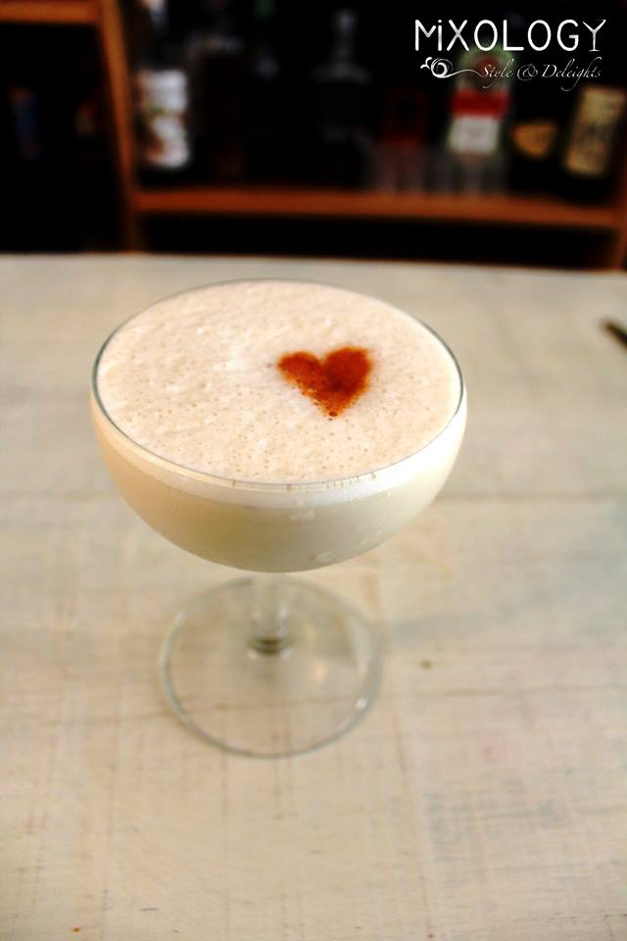
valetin
INGREDIENTES:
45 ml Corralejo Reposado
20 ml Licor Horus
20 ml Almonds Milk
20 ml Condensed Milk
20 ml Cinammon Cyrup
Dash angostura Bitter (heart shape)

