Slide 1
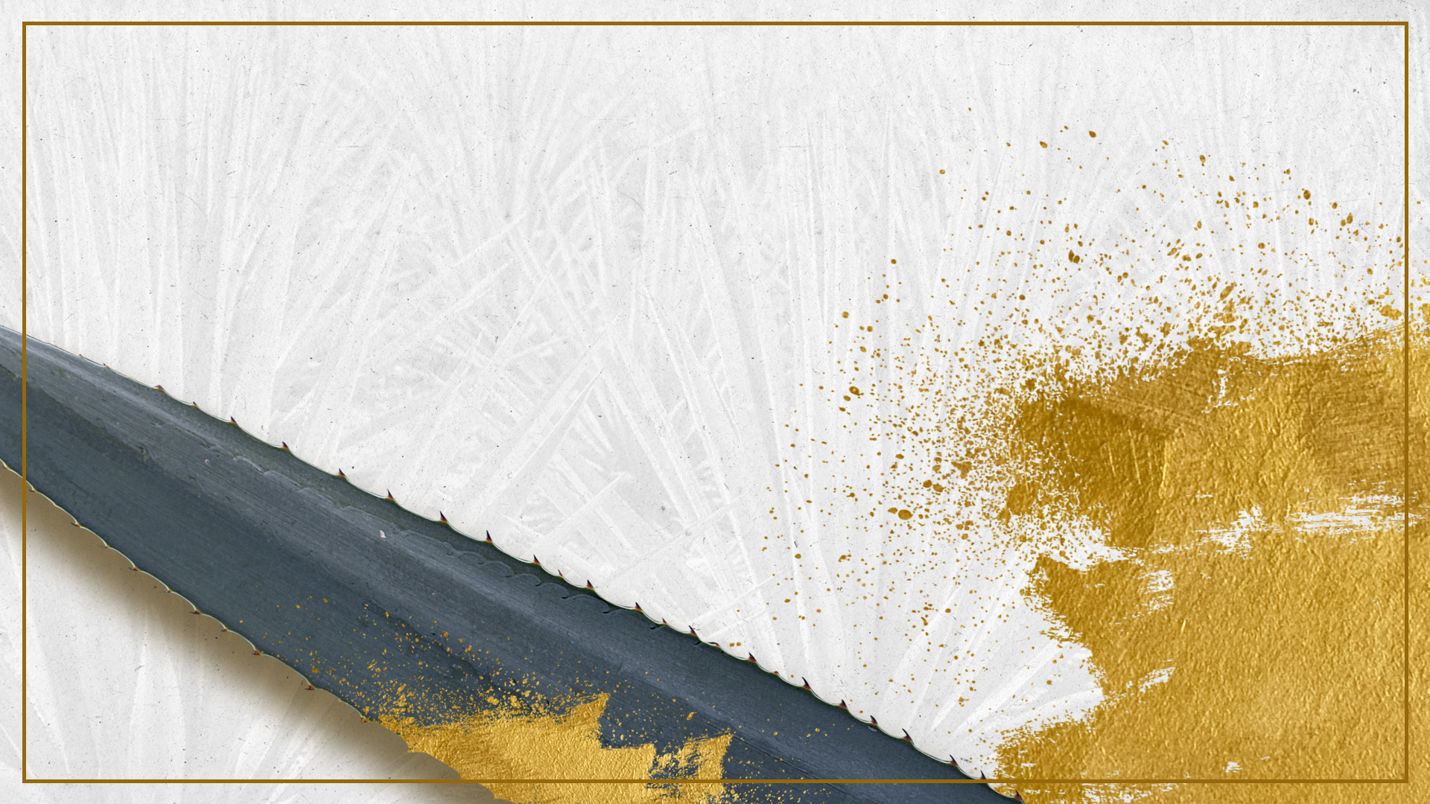

LICOR DE TEQUILA CORRALEJO
www.tequilacorralejo.mx
www.fraternityspirits.com
FB: @FraternitySpirits
IN: @fraternity_spirits
FB & IN: @tequilacorralejo

Slide 2
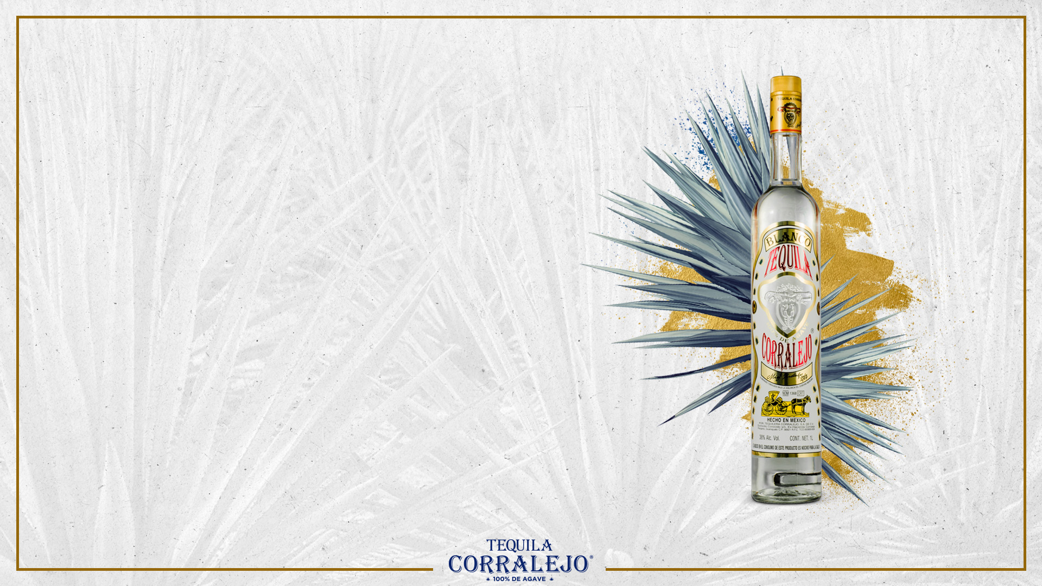
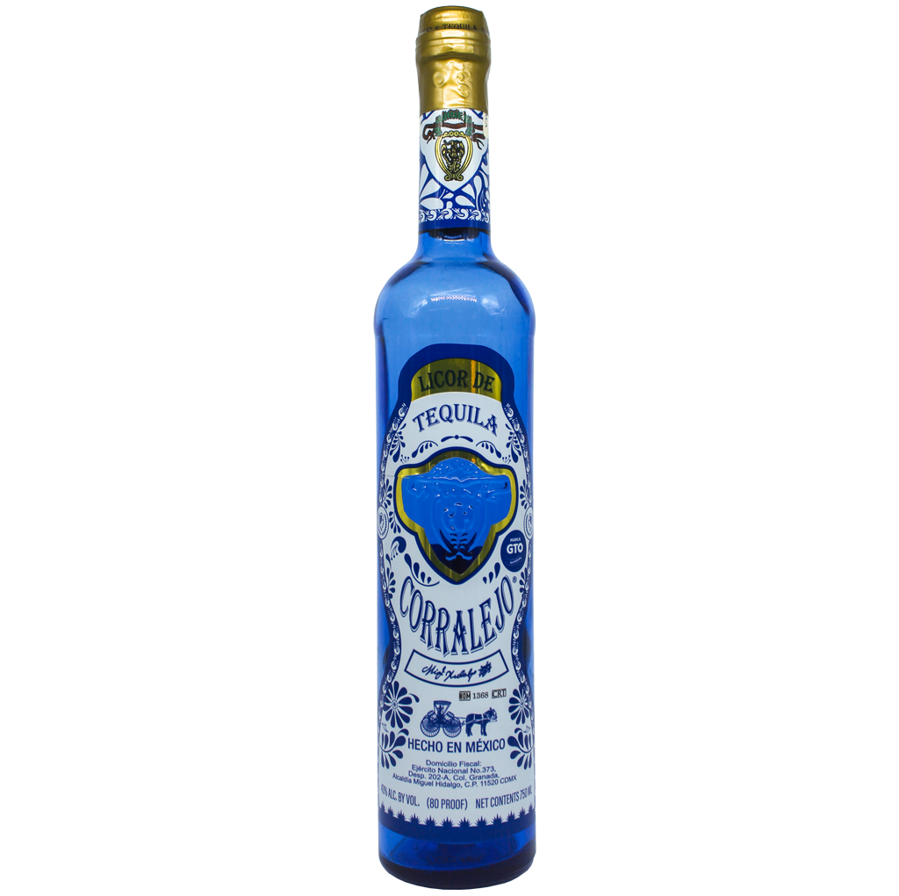
LICOR DE TEQUILA BLANCO CORRALEJO
www.tequilacorralejo.mx
www.fraternityspirits.com
It´s a silky, unctuous and aromatic high –grade liquor enriched with agave sugar obtained from the slow distillation of 100% Blue Tequilana Weber agave, and the sweet and delicate mixture of secret ingredients which rests in a stainless steel tank in order to enhance and permeate it nature flavors and cooked agave notes and aromas, resulting an excellent high-grade liquor ideal as a digestive and for creating cocktails.
Appereance: Crystalline with stow yellow nuances and silver flashes.
Aroma: Delicate floral and fruity citric notes, intense aroma of cooked agave and accents of herbal notes.
Taste:. Silky and harmonious finish on the palate with fresh and herbal notes, maintaining an exact fusion between cooked agave and fruity flavors.
ABV: 40%.

Slide 3

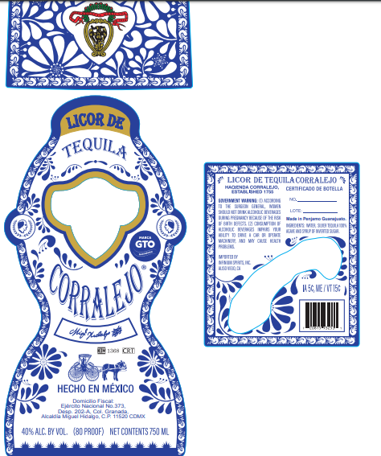
LABEL

Slide 4
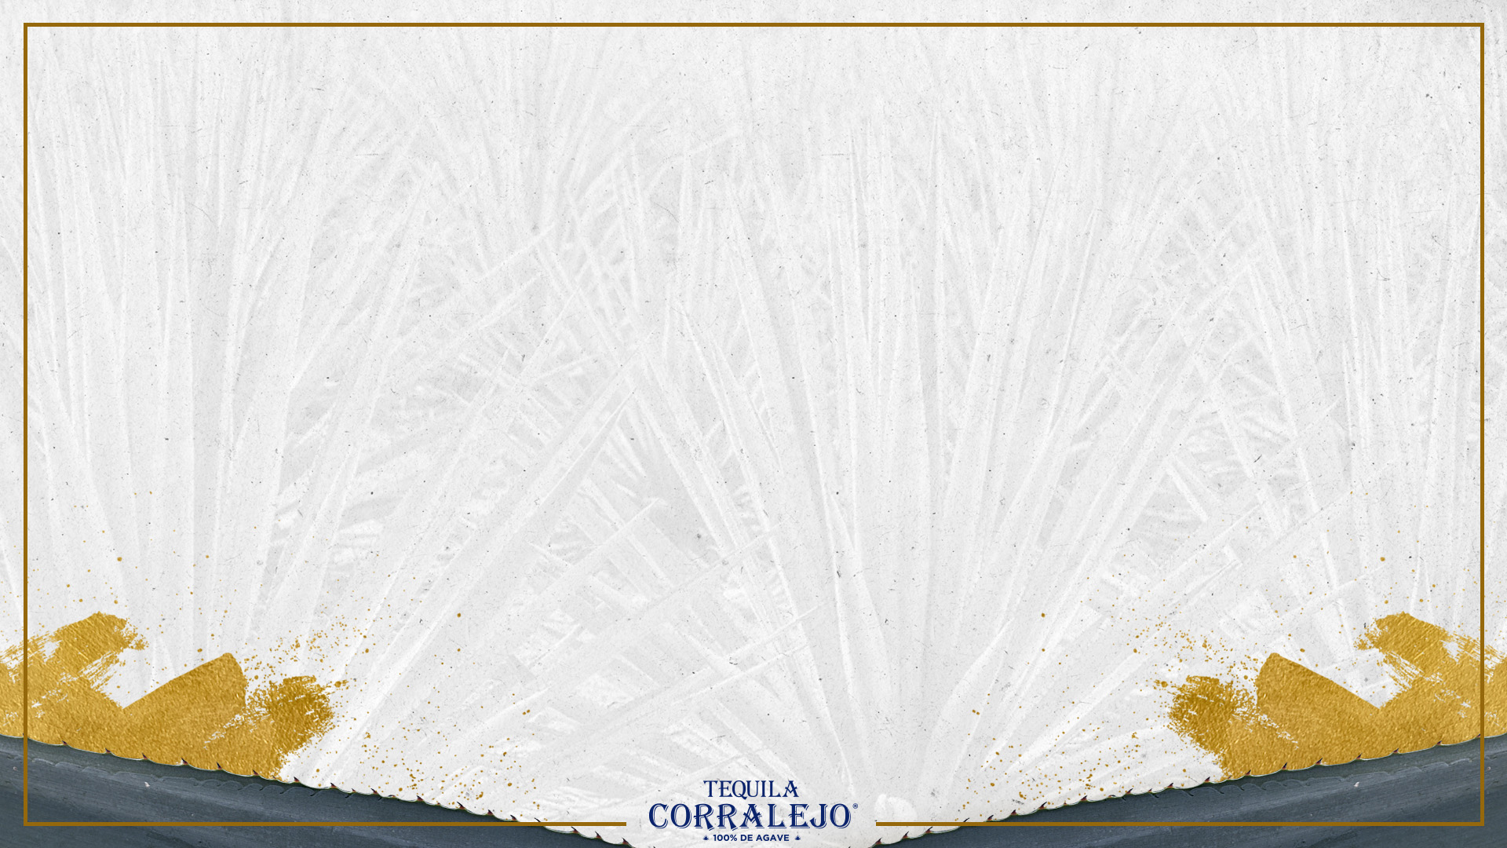
DATA SHEET
www.tequilacorralejo.mx
www.fraternityspirits.com

Slide 5
US LIQUEURS BENCHMARK
www.tequilacorralejo.mx
www.fraternityspirits.com

Slide 6
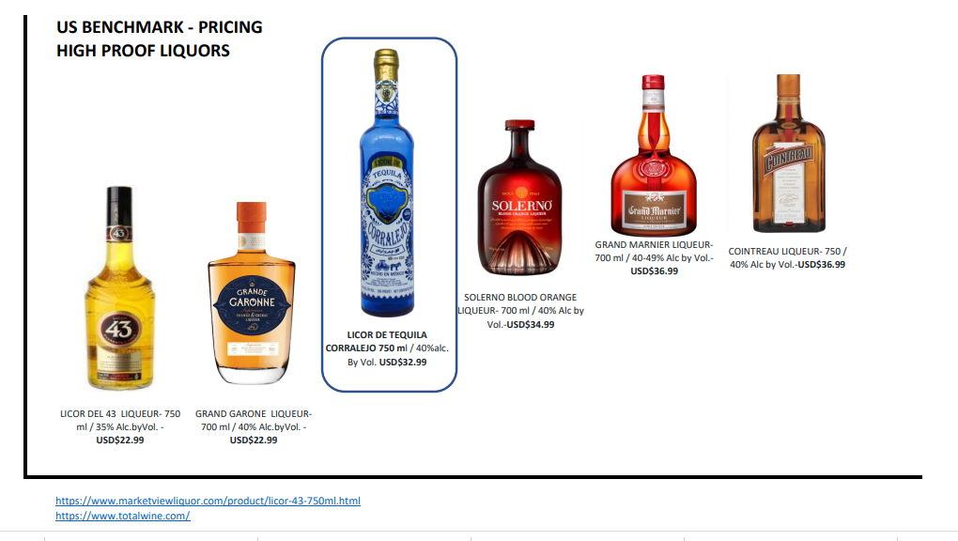

Slide 7
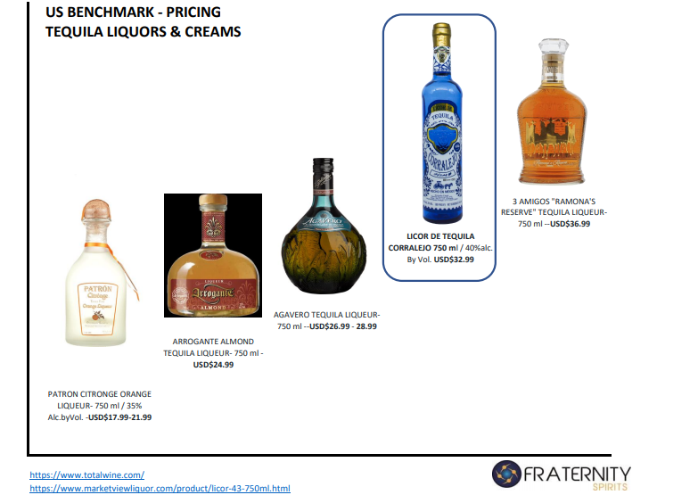

Slide 8
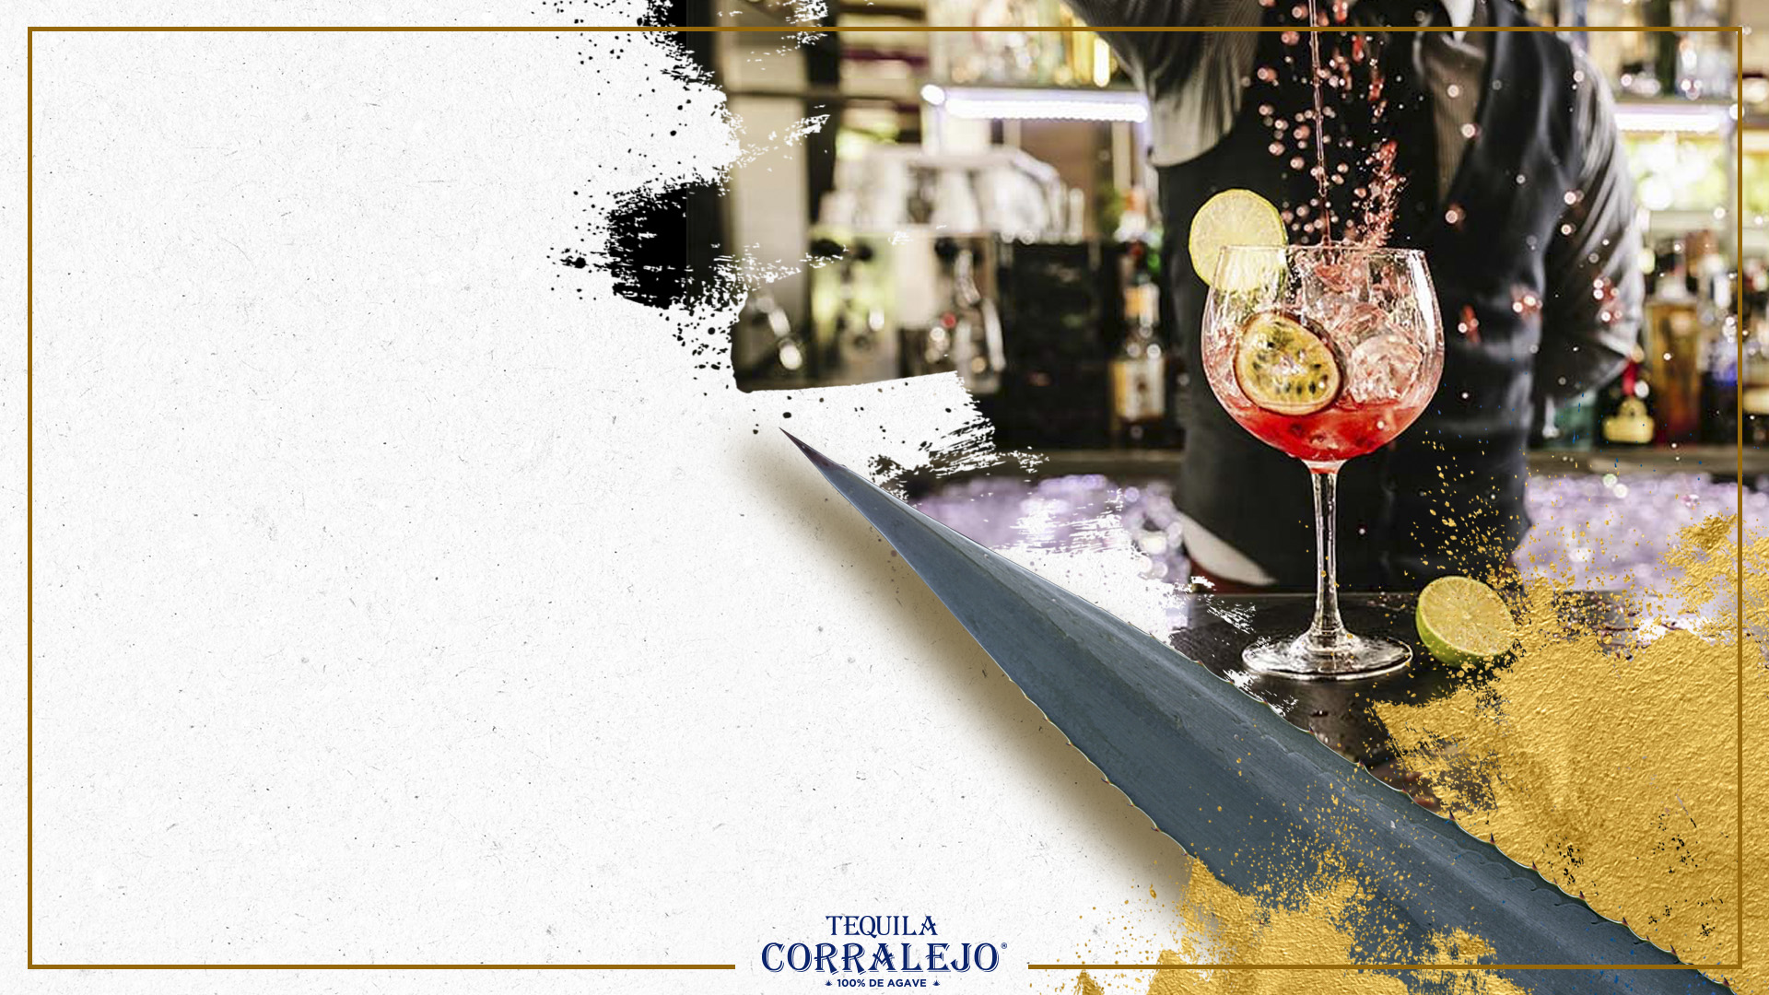
MIXOLOGY

Slide 9
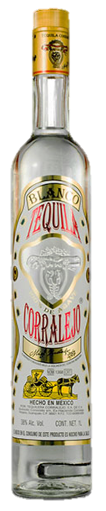
MARGARITA PEPPERMINT
www.tequilacorralejo.mx
www.fraternityspirits.com
INGREDIENTES
1 1/2 oz Licor de Tequila Corralejo 40º
1/2 oz Tequila Silver Corralejo
3/4 oz Lime Juice
½ oz Peppermint syrup
METHOD
Add all the ingredients to the shaker
Add some ice cubes
Shake well
Frost the glass with salt and sugar
Strain and Serve
GARNISH
Lime Slice
Peppermint
GLASS
- Margarita Glass

Slide 10
COSMOBERRY
www.tequilacorralejo.mx
www.fraternityspirits.com
INGREDIENTES
1 1/4 oz Licor de Tequila Corralejo 40º
3/4 oz Tequila Silver Corralejo.
3/4 oz Lime Juice
3 oz Cranberry / Blueberry
½ oz Rosemary syrup
METHOD
Add all the ingredients to the shaker
Add some ice cubes
Shake well
Frost the glass with salt and sugar
Strain and Serve in a glass with icecubes.
GARNISH
Dried citric.
Fresh Rosemary
GLASS
- Old Fashion

Slide 11
www.tequilacorralejo.mx
www.fraternityspirits.com
FB: @FraternitySpirits
IN: @fraternity_spirits
FB & IN: @tequilacorralejo

