Slide 1
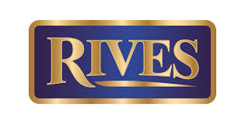

PRICE POSITIONIG USA 2019
RIVES 1880 LONDON DRY GIN & PINK GIN

Slide 2
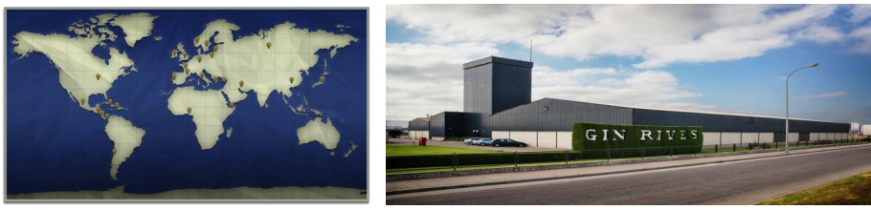
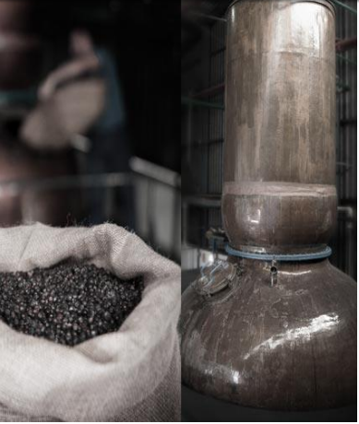
RIVES HISTORY
In 1880 Rives was founded by Mr. Augusto Haupold. Initially the company focused on the manufacture and sale of wine and brandy.
In 1965, Rives underwent a major reorganization where the grandson of the founder, Augusto Romero Haupold, introduced a full board structure and brought in directors who would help him achieve a new vision of a new dynamic Rives Pitman S.A. New marketing, promotion and distribution techniques modeled on companies from Northern Europe and USA, which had pioneered successful strategies, were implemented.
From that point on, the company has had tremendous increase of efficiency and sales, while keeping true to the traditions of distilling a quality product that Rives has done throughout it’s history of a one hundred and twenty years. The rigorous high standard controls that Rives has maintained throughout the years allow the company to export their quality results to other global markets where people of the world can taste the delicious nature of a true Spanish made product.

Slide 3
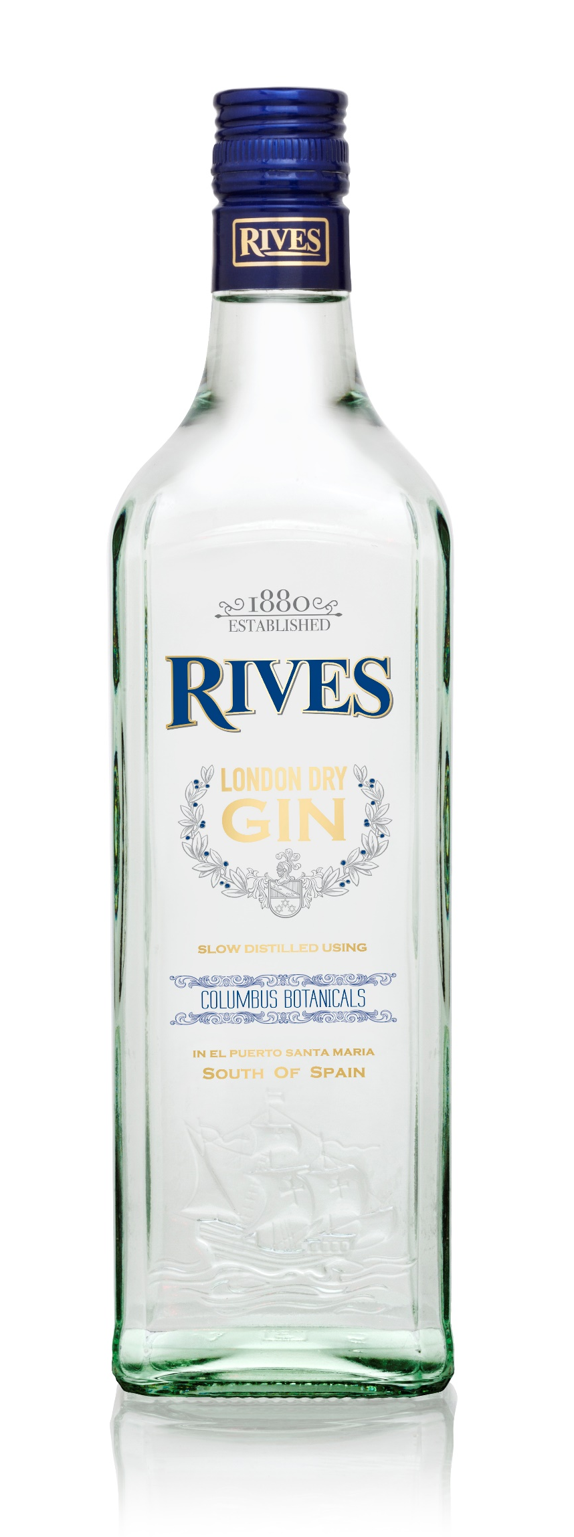
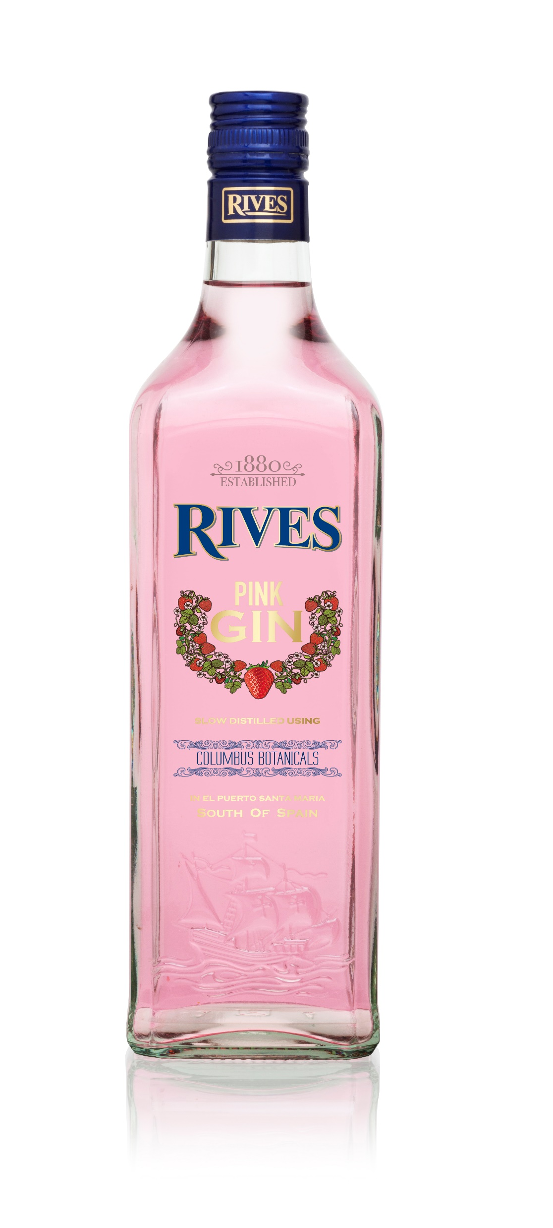
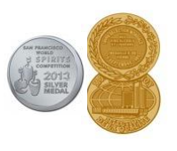
RIVES 1880 LONDON DRY
PINK RIVES GIN
Rives 1880 is a very special Spanish and internationally renowned made from pure grain spirit distilled 3 times in John Dore copper pot stills in accordance with the highest quality standard demanded for London Dry Gin.
Gin Rives has been produced in El Puerto De Santa Maria since 1880, with extreme refinement and care, respecting the original recipe, which distinguishes its clean dry taste. Eight different kinds of seeds and natural plants are used in the production, from many places of the world, all enhancing its own taste and aroma: Spanish Juniper, Moroccan Coriander, Belgian Angelica, Chinese Cassia, Italian Orris, Spanish Orange and Lemon and Chinese Liquor ice.
TASTING NOTES
Nose: Clean and delicate.
Palate: Smooth, light and dry. Fresh citrus notes make Rives 1880 a perfect choice for classic long drinks.
Finish: Long
ABV: 40 %
AWARDS: Silver Medal in San Francisco World Spirits Competition 2013
Our Pink Rives Gin is made with the our Original London Gin and the maceration of the best Strawberries from South of Spain.
This is an authentic, hand crafted gin with delicious hints of strawberry.
Using this new recipe , it guarantees a smooth, fresh flavour and a attractive pink color.

Slide 4
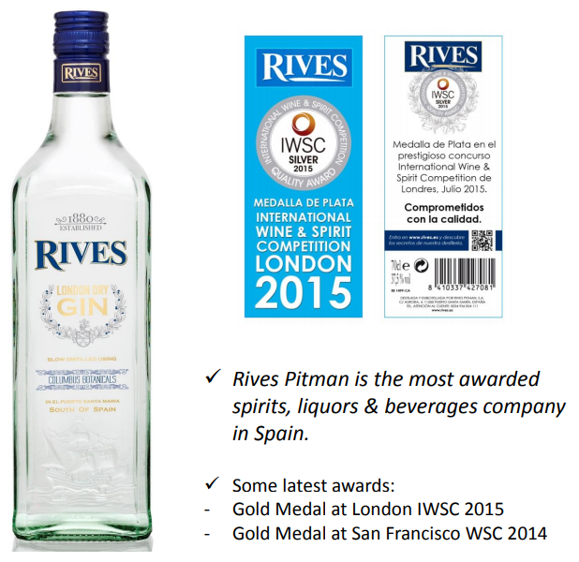
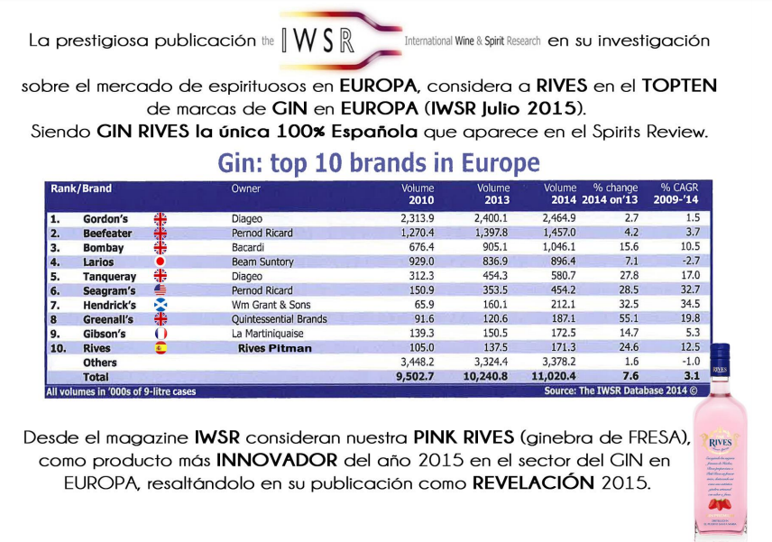

Slide 5
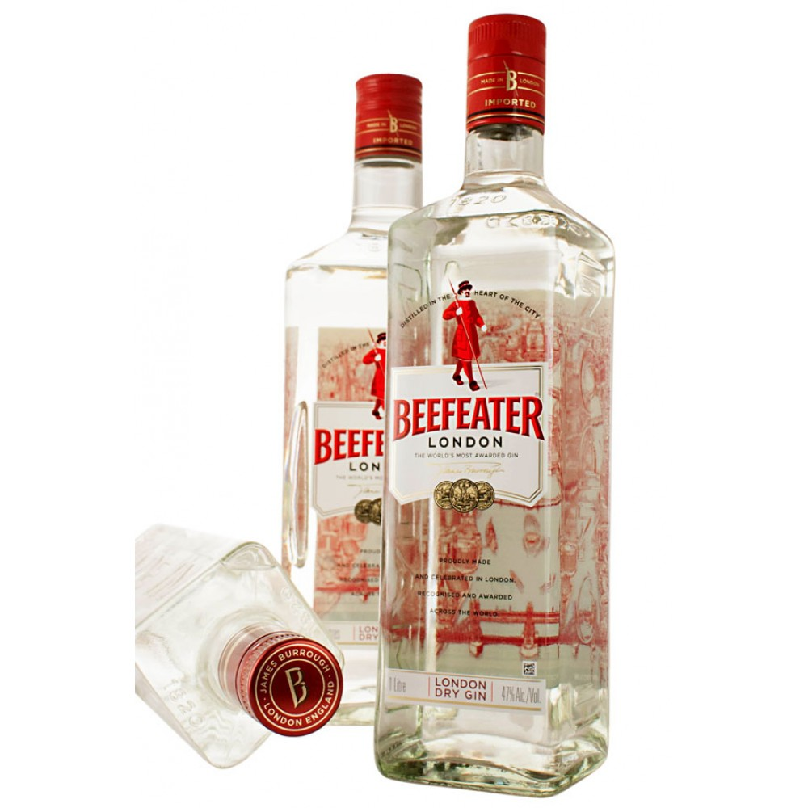
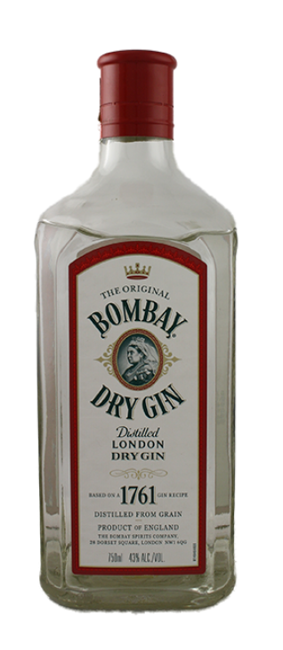
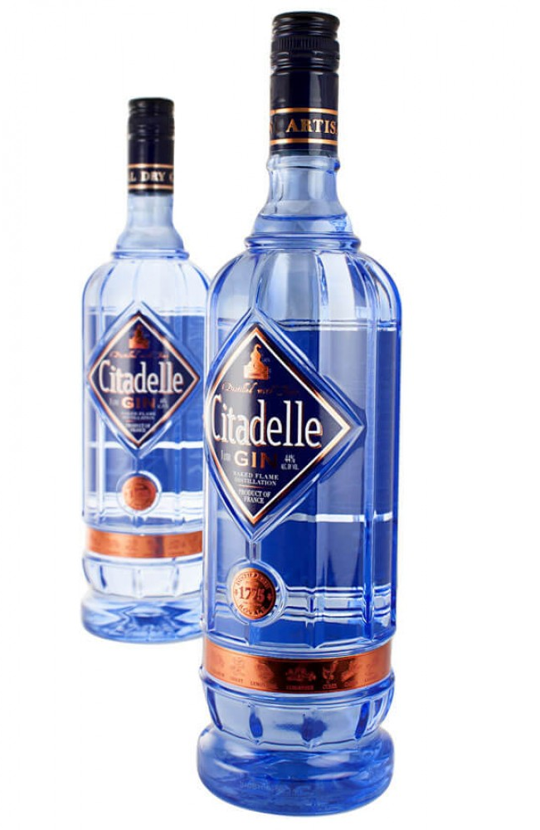
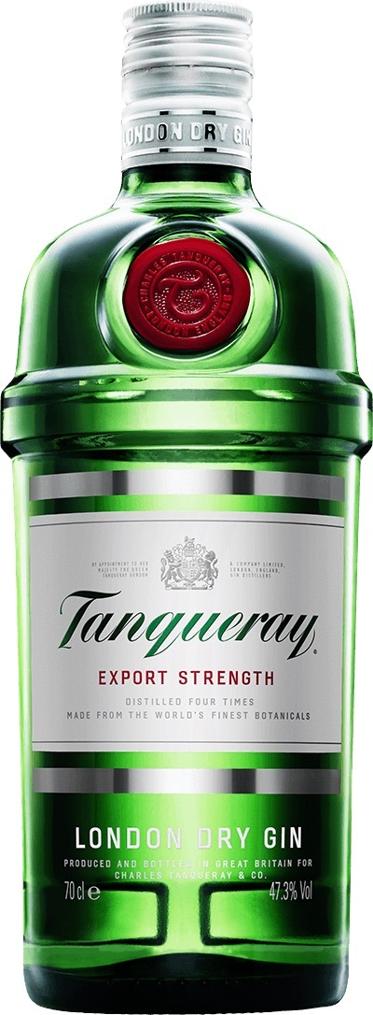

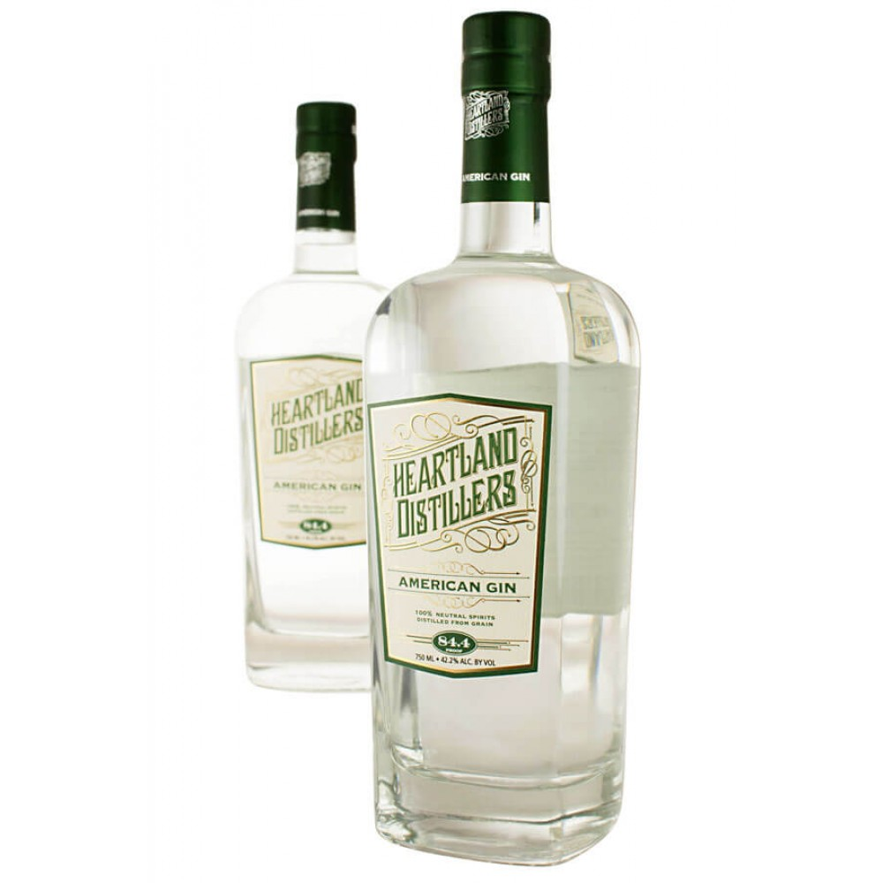
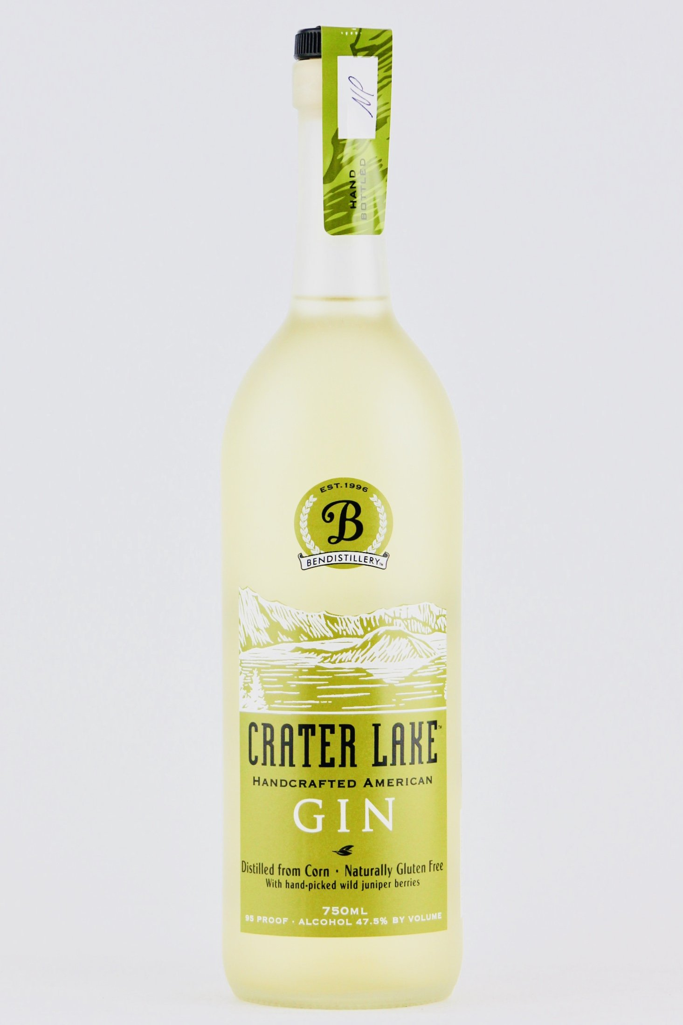

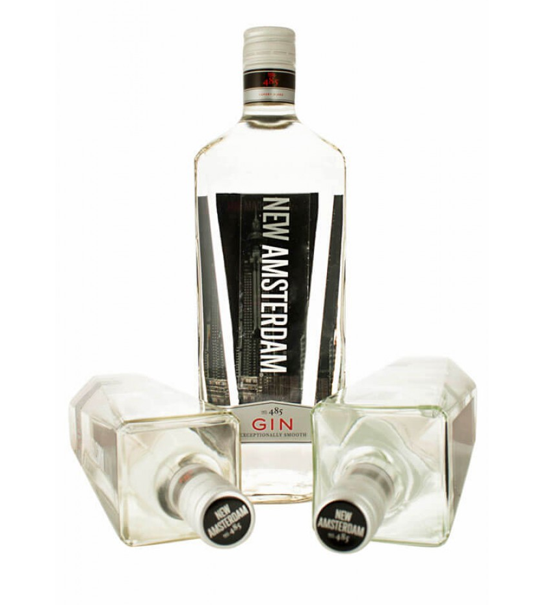
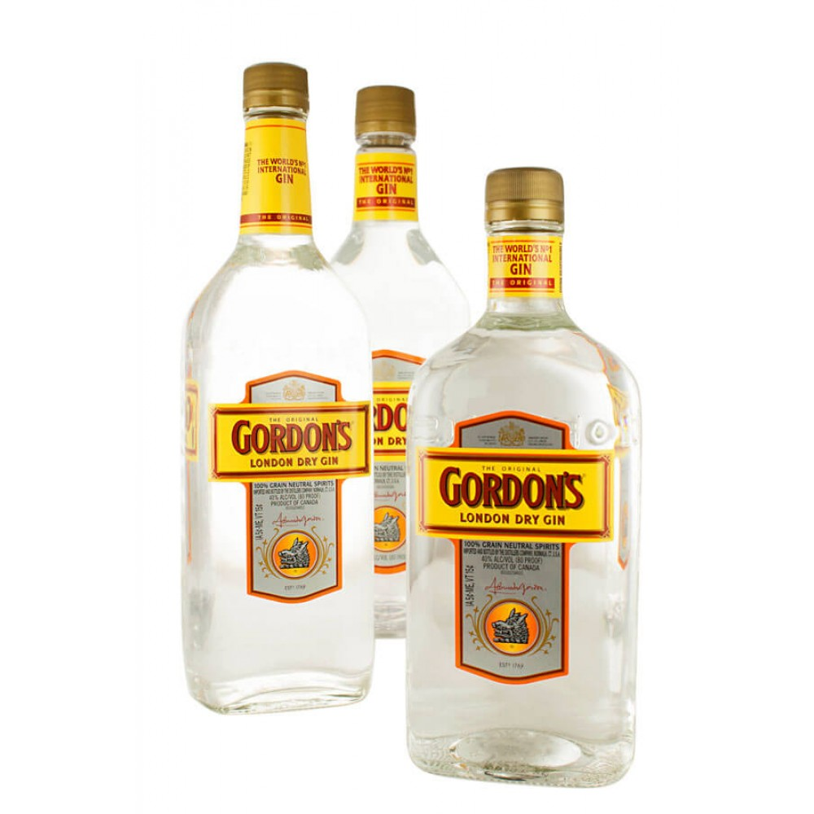
BENCHMARK PRICING & COMPETITION
Beefeater London Dry Gin
Country: UK
Bombay Dry Gin
Country: UK
Citadelle Gin
Country: France
Tanqueray London Dry Gin
Country: UK
Brokers London Dry Gin
Country: UK
750 ml
USD $22.99 / 19.99
750 ml
USD $22.99 / 19.97
750 ml
USD $17.99 / 21.99
750 ml
USD $19.99 / 22.99
750 ml
USD $19.99 / $21.99
Heartland Distillers Gin
Country: USA
Crater Lake Gin
Country: USA
Hana Gin
Country: USA
New Amsterdam Gin
Country: USA
Gordons London Dry Gin
Country: UK
750 ml
USD $21.99
750 ml
USD $20.00
750 ml
USD $19.99
750 ml
USD $15.99
750 ml
USD $15.99

Slide 6
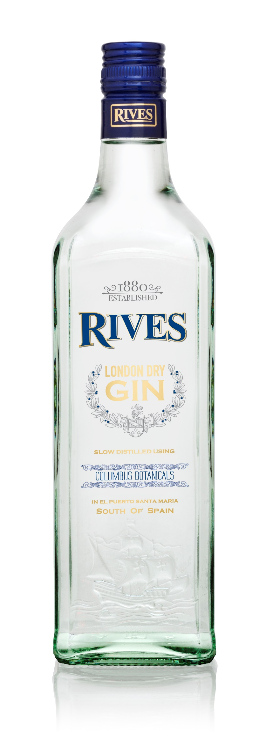

MAP BRAND PRICE POSITIONIG
1880 USD$ 18.99 - $ 20
PINK_USD$ $22.99

