Slide 1
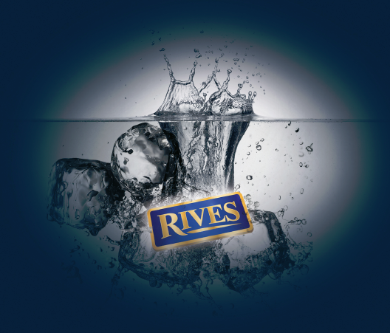

Slide 2
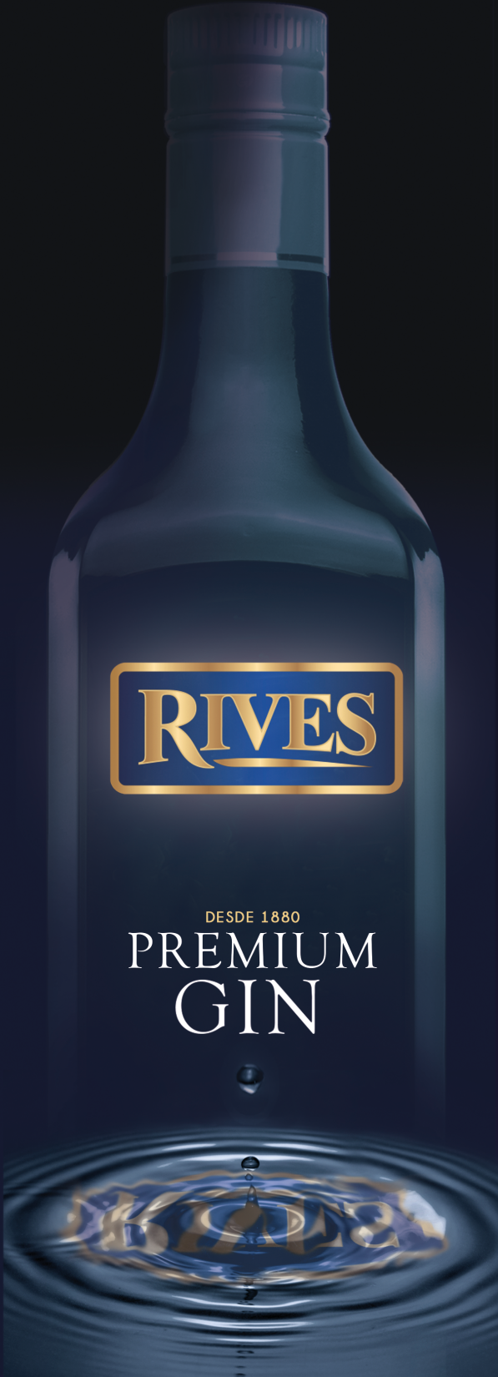
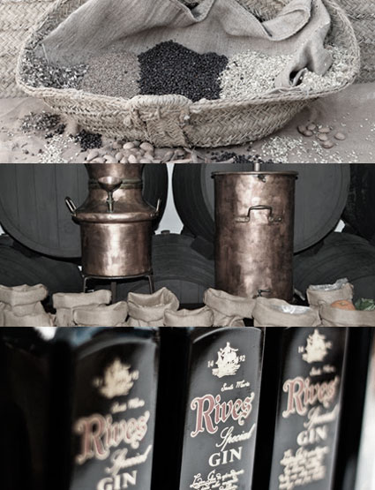
THE COMPANY
Rives Group is a 100% Spanish owned family business, specializing in the production and distribution of distilled spirits, liqueurs and non alcoholic concentrates.
The company has a wide and varied range of own-brand products, including the Group´s flagship product, the 1880 Rives Gin, in addition to being the clear market leader in Spain with its range of non alcoholic beverages.
The Group combines traditional production processes with the most advanced technology to make all its different products.

Slide 3
FAMILY TRADITION
1880. Rives' history dates back to 1880 when the company was established by Don Augusto Haupold, German consul in Malaga and visionary entrepreneur. He soon built the company into one of the pioneering wineries in the Jerez area, initially focused on the production and sale of local wine and brandy.
1900. Copper pot stills were brought from UK and used for the first time to make Rives Triple Sec and Rives Mint Liqueur along with other popular liqueurs of the time such as Coffee and Chocolate.
1976. Rives built a new distillery, state of the art blending and bottling facilities, boiler house, laboratory etc. Also one of the tallest rectification towers of alcohol in Europe.
1980. Triple Distilled Rives Special Gin is distilled for the first time.
1995. Rives launches its new range of non-alcoholic liqueurs which includes Green Apple, Peach, Wild Blackberry, Hazelnut and Amaretto.
2013. Super premium vodka King Peter joins the Rives family. King Peter is distilled from the exclusive "Dankowskie" golden rye

Slide 4
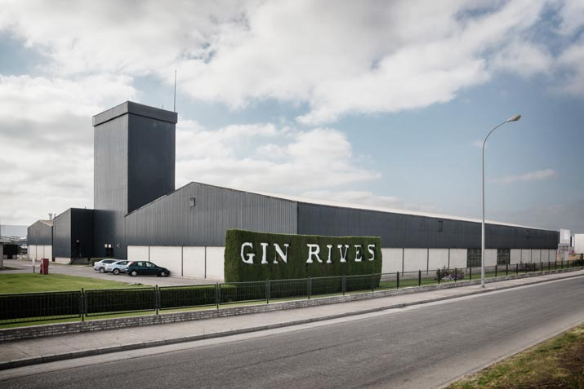
RIVES DISTILLERY
The company is located in El Puerto de Santa María in the province of Cádiz and boasts one of the most advanced distilleries in Europe with 30 m high column stills, two large hundred-year-old John Dore copper pot stills, which are used for the distillation of the botanicals and a reverse osmosis water treatment plant.
The bottling area is responsible for packaging the entire production and comprises three bottling lines with a capacity of up to 18,000 bottles per hour.
In addition, Rives has a state of the art laboratory which is responsible for quality control, research and development of new flavors and colors for future launches. This activity gives Rives the agility and creativity to continue to lead product innovation in the market.

Slide 5
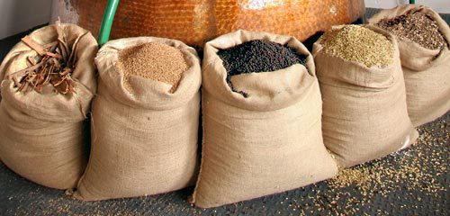
LONDON DRY GIN
Rives Gin is still produced by traditional methods using top quality alcohol and botanicals to recipes passed down from master distillers of another age.
True London Dry Gin is a much more refined product crafted with great care by experienced distillers. It uses the highest quality fermentation alcohol with botanicals, dominated by Juniper.
The secret of London Dry Gin lies in the purity of the alcohol and the proportion of botanicals used in each distillation. The alcohol used in our Gin is either from fermented molasses or grain with a purity of at least 96%
The careful selection and a perfect combination of its natural ingredients give these gins an exceptional
^{SMOOTHNESS}

Slide 6
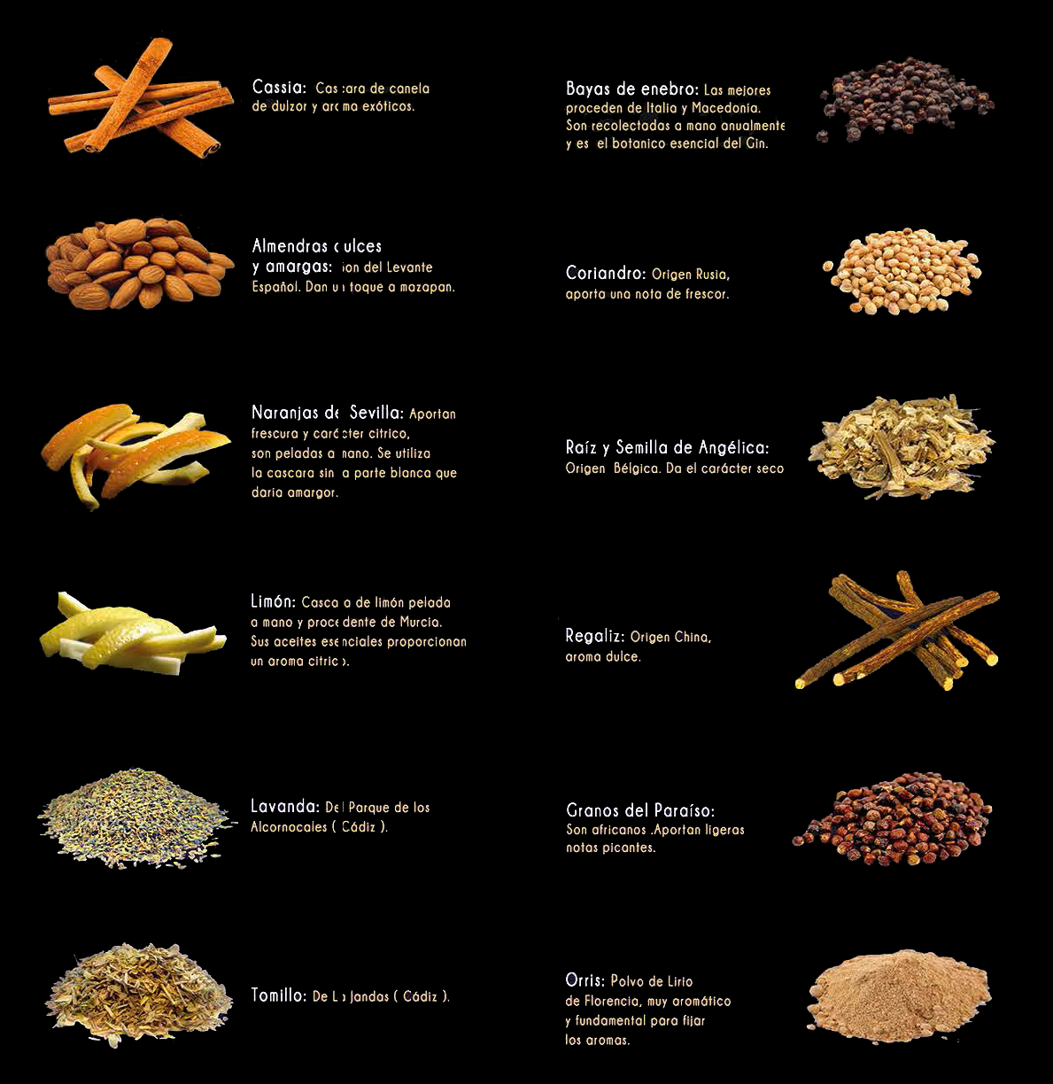




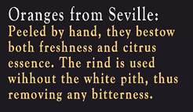

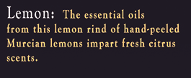






Slide 7
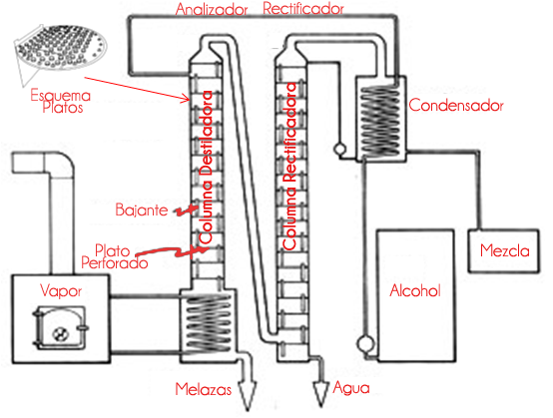
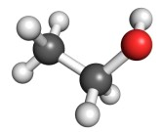
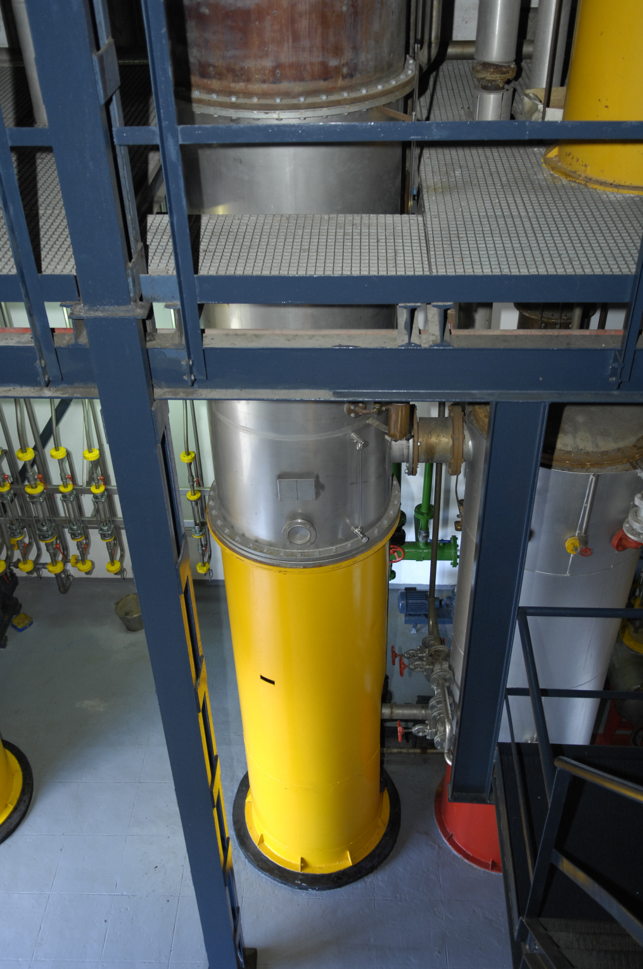
^{Distillation Process}
30 m high column stills
Molasses
or Grain
alcohol
A unique 30 m high column stills to rectify the alcohol and reduce any further impurities; one of the highest distilleries in Europe.

Slide 8
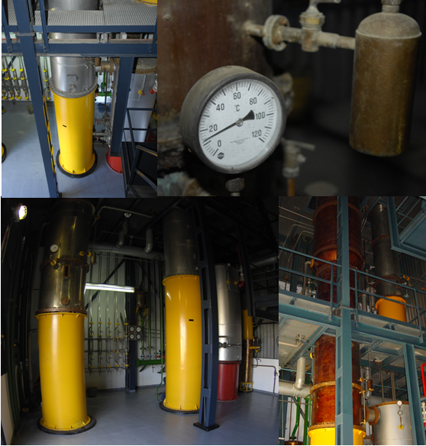
A reverse osmosis water process is made
to obtain a 100% pure water.

Slide 9
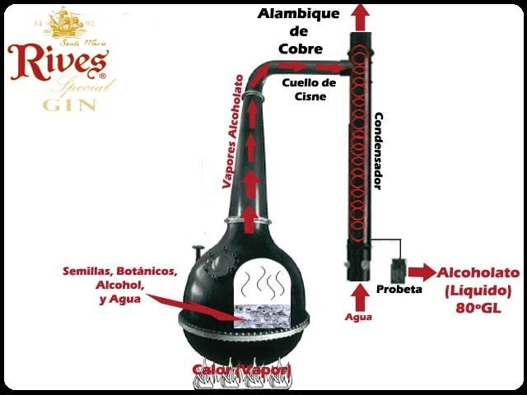
^{Distillation Process}
The method used is “batch distillation” in a pot still.
Two large hundred-year-old copper pot stills
The alcohol is charged into the pot of the still and reduced with water before the botanicals are added in carefully controlled amounts
The botanics are left to macerate for about 24 hours

Slide 10
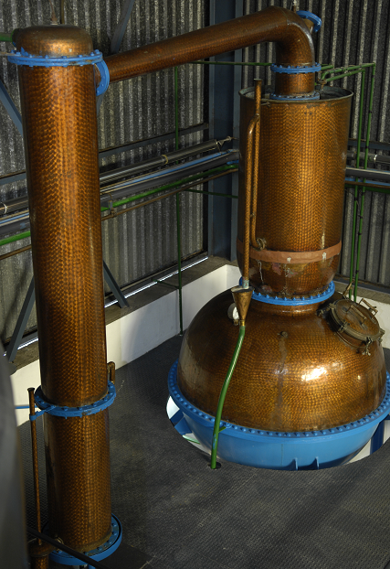
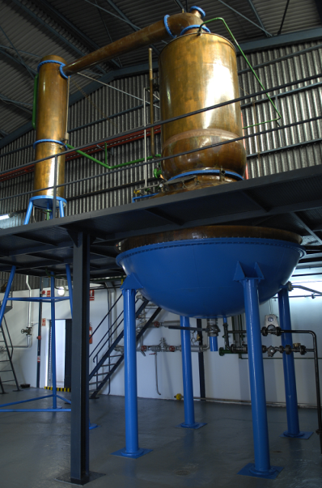
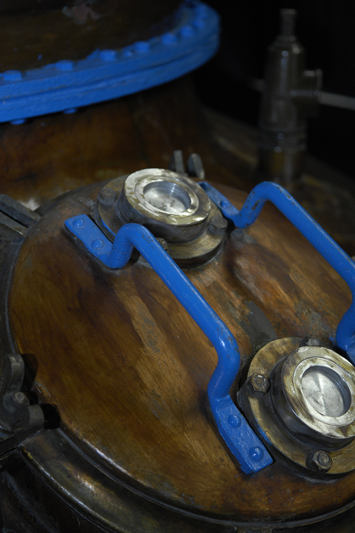
The Master Distiller throw away both the ‘heads’ and ‘tails’ of the distillate, selecting only the ‘heart’ (middle body), right at the point when the taste and the botanical concentrates are optimum.
The resulting distillate is left to settle for no less than two weeks, thus allowing the botanicals’ essentials oils to blend perfectly with the product.

Slide 11
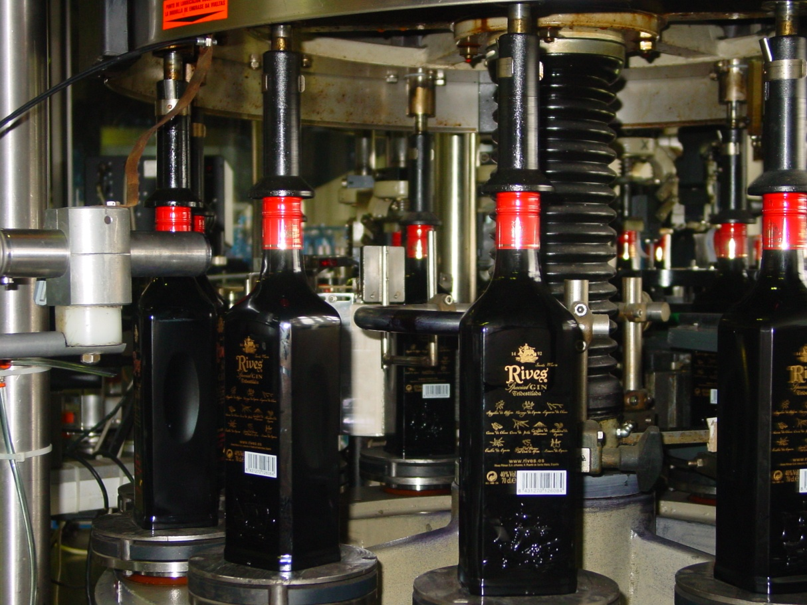
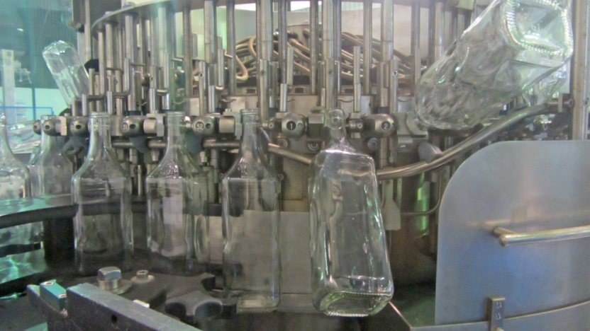
THE BOTTLING AREA
Three bottling lines
Up to 18,000 bottles
per hour.
Cleaning the bottles with gin before bottling

Slide 12
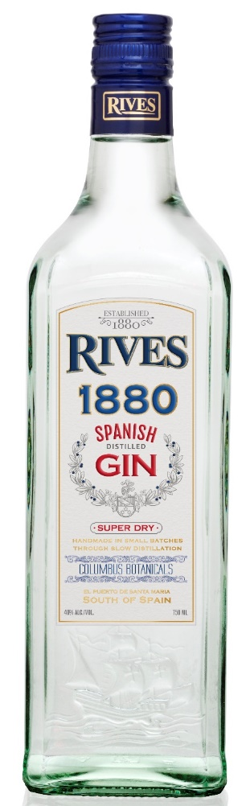


RIVES 1880 GIN
“The gin with touches of bitter orange”
Spanish Gin, internationally renowned, is distilled to the London Dry Gin style.
Gin Rives has been produced in El Puerto De Santa Maria since 1880, with extreme refinement and care, respecting the original recipe, which distinguishes its clean dry taste.
Eight different kinds of seeds and natural plants are used in the production, from many places of the world, all enhancing its own taste and aroma: Spanish Juniper, Moroccan Coriander, Belgian Angelica, Chinese Cassia, Italian Orris, Spanish Bitter Orange, Lemon and Chinese Liquorice.
40º alcohol content.

Slide 13
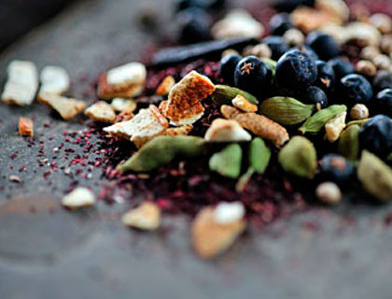
RIVES 1880 GIN
Juniper berries, Coriander, Angelica Root, Cassia,
Liquorice, Orris root, Bitter Orange and Lemon peel.
Tasting notes:
Visual aspect: | Transparent and bright
On the nose: | Aromatic, clean, juniper tones and citric base note
On the palate: | Dry and smooth, with a fresh and citric aftertaste

Slide 14
RIVES 1880 GIN
The bottle’s grass engraving represents the historical flagship Santa Maria, the largest of the three ships used by Christopher Columbus in his first voyage to the New World.
The expedition set off from the Guadalete river, next to the original distillery in El Puerto de Santa María (south of Spain), giving the bottle a symbolic connection to our city.

Slide 15
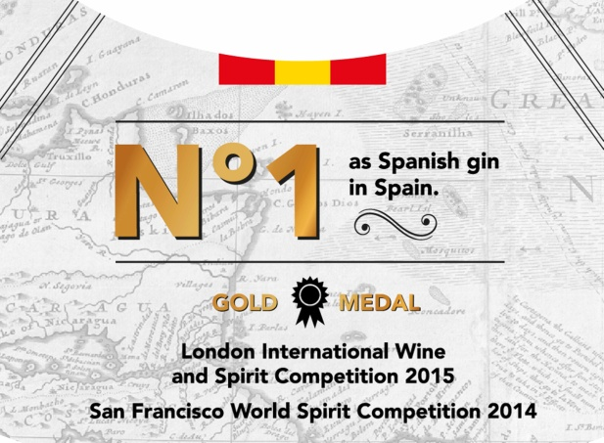
RIVES 1880 GIN
Rives Dsitillery is the most awarded spirits, liquors & beverages company in Spain.
Some latest awards:
Gold Medal at London IWSC
Gold Medal at San Francisco WSC

Slide 16
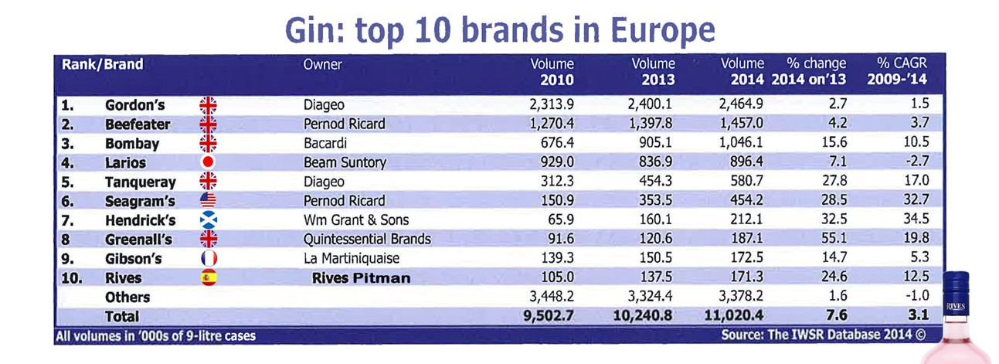
RIVES 1880 GIN

Slide 17
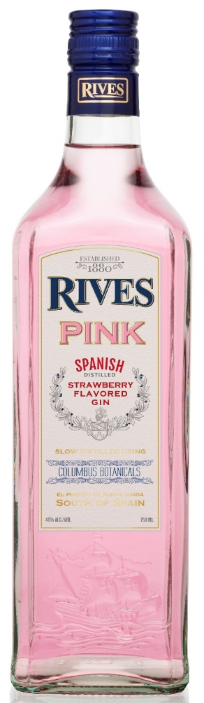
RIVES PINK GIN
Our Pink Rives Gin is made with our 1880 Gin and the maceration of the best Strawberries from South of Spain.
This is an authentic hand-crafted gin with delicious hints of strawberry.
Using this new recipe , it guarantees a smooth, fresh flavor and an attractive pink color.
Alcohol content: 40%

Slide 18
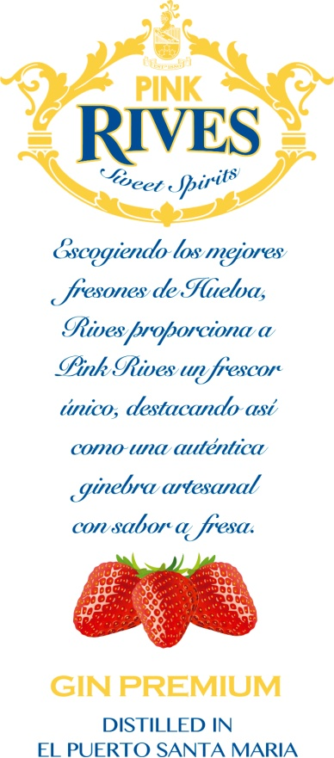
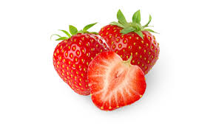
RIVES PINK GIN
Product type Triple distilled
Gin & strawberry concentrate
Alcohol 40º G.L.
System elaboration Distillation in
original alembics using the
traditional method
Tasting Notes:
Visual aspect: | Pink, transparent and bright
On the nose: | Aromatic, clean, rich in nuances
On the palate: | Sweet and fresh; aftertaste which is reminiscent of sweet strawberries

Slide 19
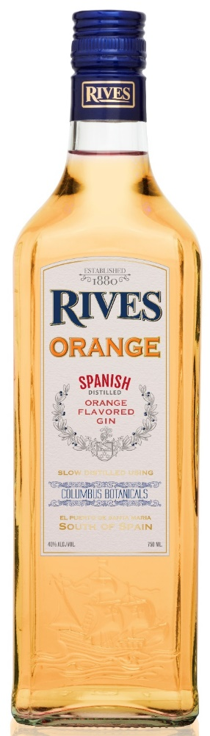
RIVES ORANGE GIN
Artisanal Mild and fresh gin, elaborated according to the 1880 formula with a selection of botanic, sweets and aromatic Oranges from Valencia and South of Andalucía.
This is an authentic hand-crafted gin with delicious hints of Spanish oranges.
Alcohol content: 40%

Slide 20
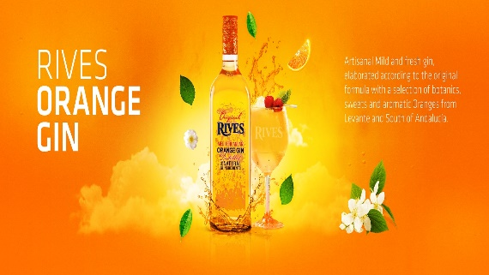
RIVES ORANGE GIN
Product type Triple distilled
Gin & orange concentrate
Alcohol 40º G.L.
System elaboration Distillation in
original alembics using the
traditional method
Tasting Notes:
Visual aspect: | Orange, transparent and bright
On the nose: | Aromatic, clean, rich in nuances
On the palate: | Sweet and fresh; aftertaste which is reminiscent of sweet Oranges

Slide 21
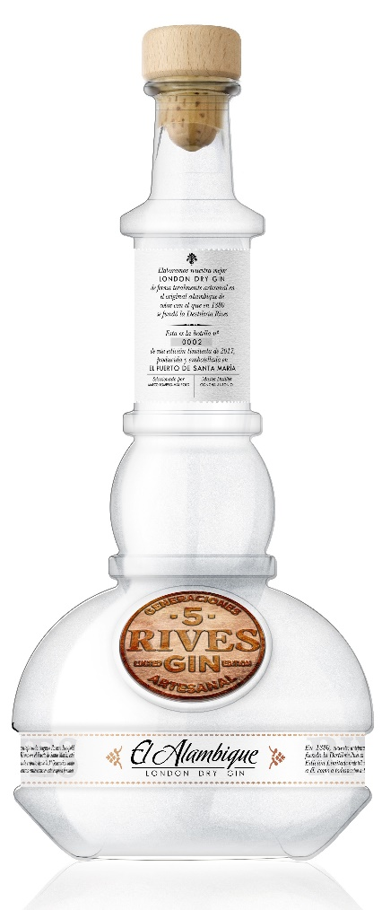
RIVES EL ALAMBIQUE GIN
We elaborate “El Alambique” artisanal gin with 100% botanicals from south of Spain, among them, the freshest MANDARIN peel from Seville.
This limited edition is a tribute to the 5 generations of distillers from the Romero-Haupold family, specially to Don Augusto, who in 1880 founded our company with the same copper pot still that even today we use. This bottle is a replica.
Alcohol content: 42%

Slide 22
RIVES EL ALAMBIQUE GIN
Product type Triple distilled
Gin & Mandarin concentrate
Alcohol 42º G.L.
System elaboration Distillation in
original alembics using the
traditional method
Tasting Notes:
Visual aspect: | Transparent and bright
On the nose: | Clean, rich in nuances, mandarins
On the palate: | Fresh; bitter and smooth, aftertaste which is reminiscent of mandarins

Slide 23
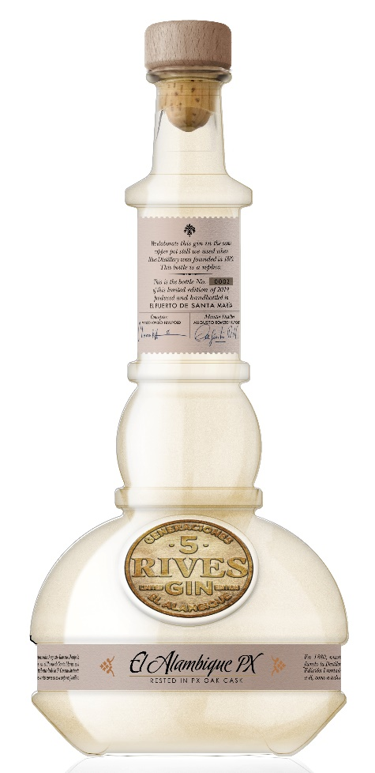
RIVES PX GIN
We elaborate this original PX Gin resting a special edition of our artisanal gin in american oak barrels where Pedro Ximenez sweet wines were aged. This brings unmistakable flavours and aromas.
This limited edition is a tribute to the 5 generations of distillers from the Romero-Haupold family, specially to Don Augusto, who in 1880 founded our company with the same copper pot still that even today we use. This bottle is a replica.
Alcohol content: 42%

Slide 24
RIVES PX GIN
Product type Triple distilled
Gin & PX Sherry wine
Alcohol 42º G.L.
System elaboration Distillation in
original alembics using the
traditional method
Tasting Notes:
Visual aspect: | Gold and transparent
On the nose: | Citrus predominant with hints of raisins and wood
On the palate: | Gentle sweetness at the start, smooth,warm with a long and rounded finish

Slide 25
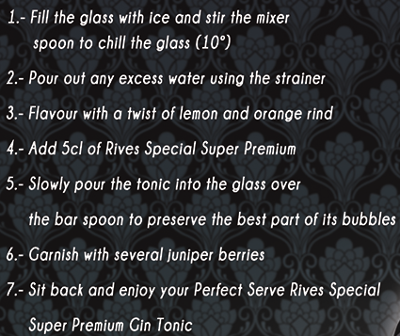
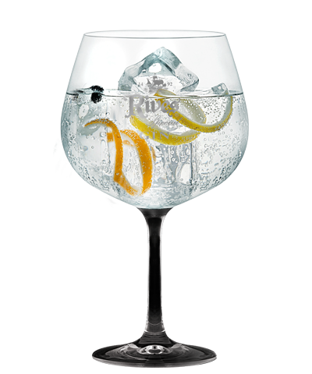
COCKTAIL ROOM

Slide 26
COCKTAIL ROOM
THE SPANISH GIN TONIC
YOU WILL NEED
5 cl. of Rives 1880 or El Alambique
Tonic
Lemon Twist
Orange Twist

Slide 27
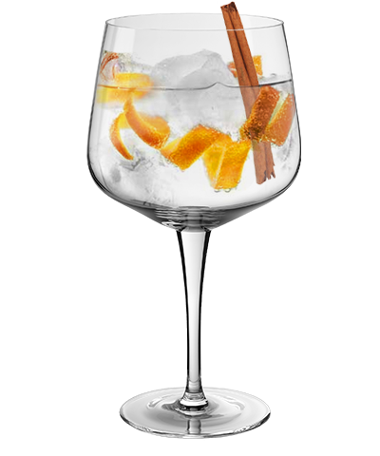
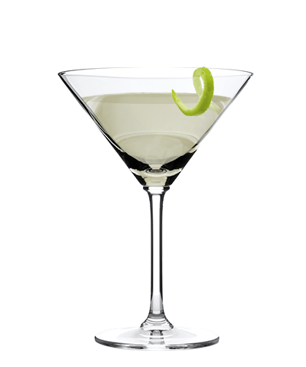
RIVES PREMIUM
SEVILLE GIN TONIC
YOU WILL NEED
5 cl. of Rives Orange
Tonic
Orange Twist
Cinammon stick
Orange blossom Aroma
RIVES DRY
YOU WILL NEED
5 cl. of Rives 1880
1 cl. of Dry Vermut
Lime slice

Slide 28
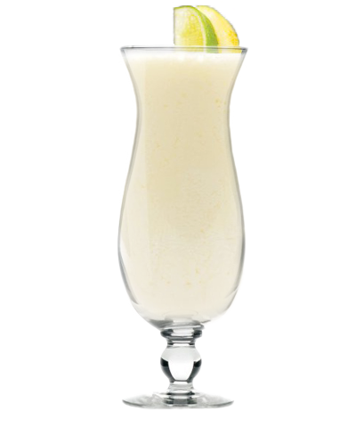
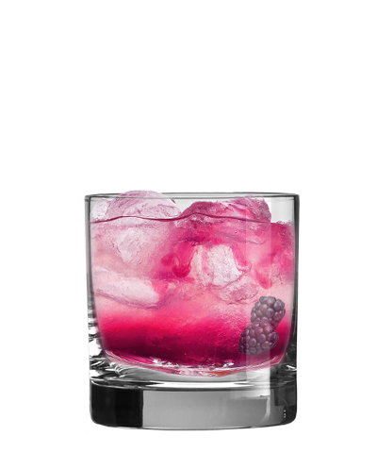
RIVES LONDON
RIVES FIZZ
YOU WILL NEED
5 cl. of Rives 1880
3 cl. of Lemon Juice
6 cl. of Soda
1 Sugar Spoon
One cherry
One Lime Slice
RIVES BRAMBLE
YOU WILL NEED
5 cl. of Rives 1880
2 cl. of Lemon Juice
15 ml sugar syroup
5 0,5 cl. of Wild Blackberry Liqueur

