Slide 1
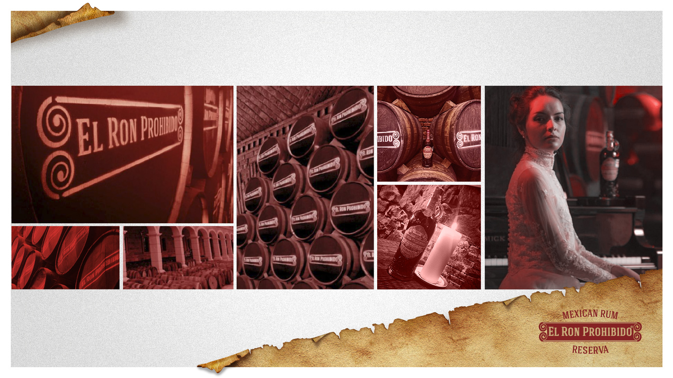
PCC Process

Slide 2
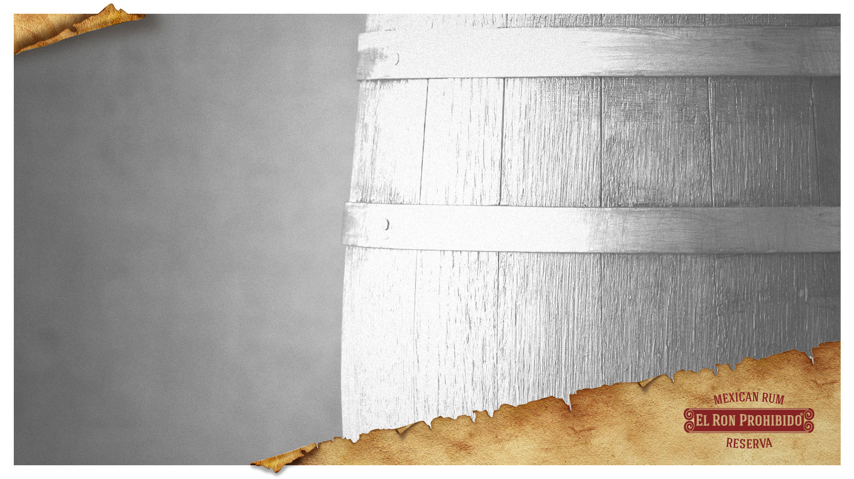

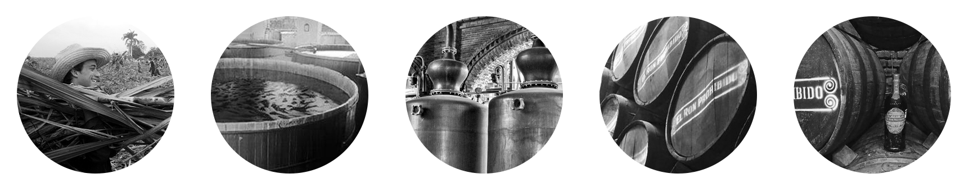
Stages of producing
The mix of El Ron Prohibido in used raisin wine barrel, improves the sweet and bitter notes making it different from others rums.

Slide 3
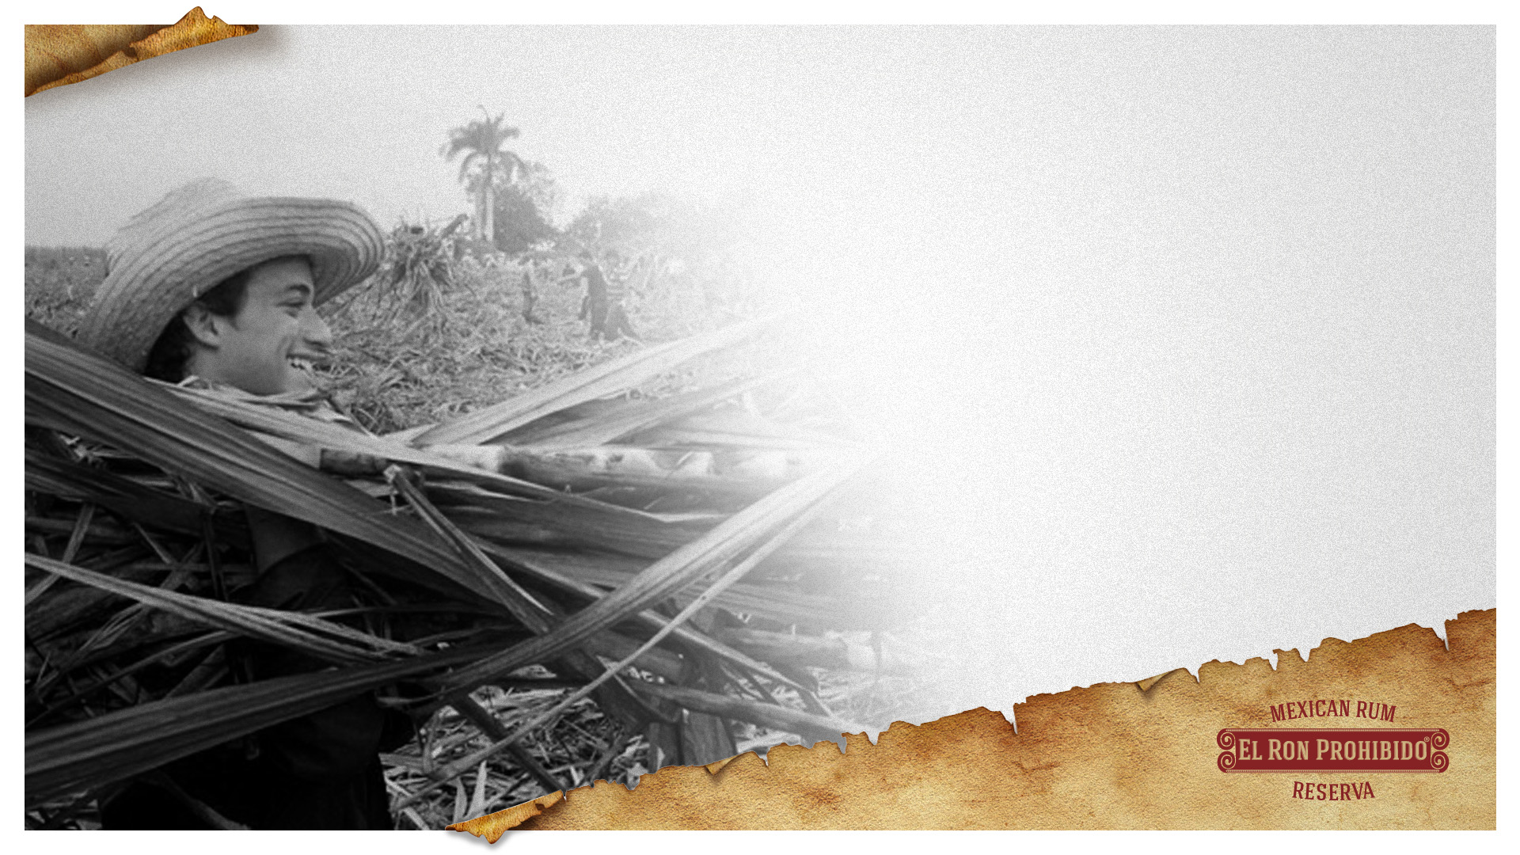

The cane is cut and squeeze in mills to extract the juice. Water is added for second extraction, then the juice is filtered and clarified to get rid of residues.

Slide 4
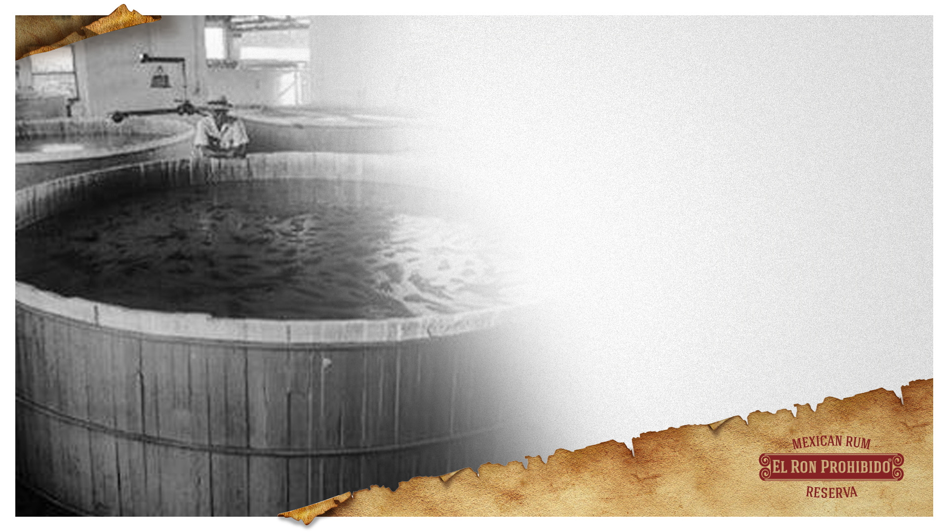

Water is added to dilute the juice and get better results. The resulting liquid after the fermetation process it’s called mosto or cane wine.

Slide 5
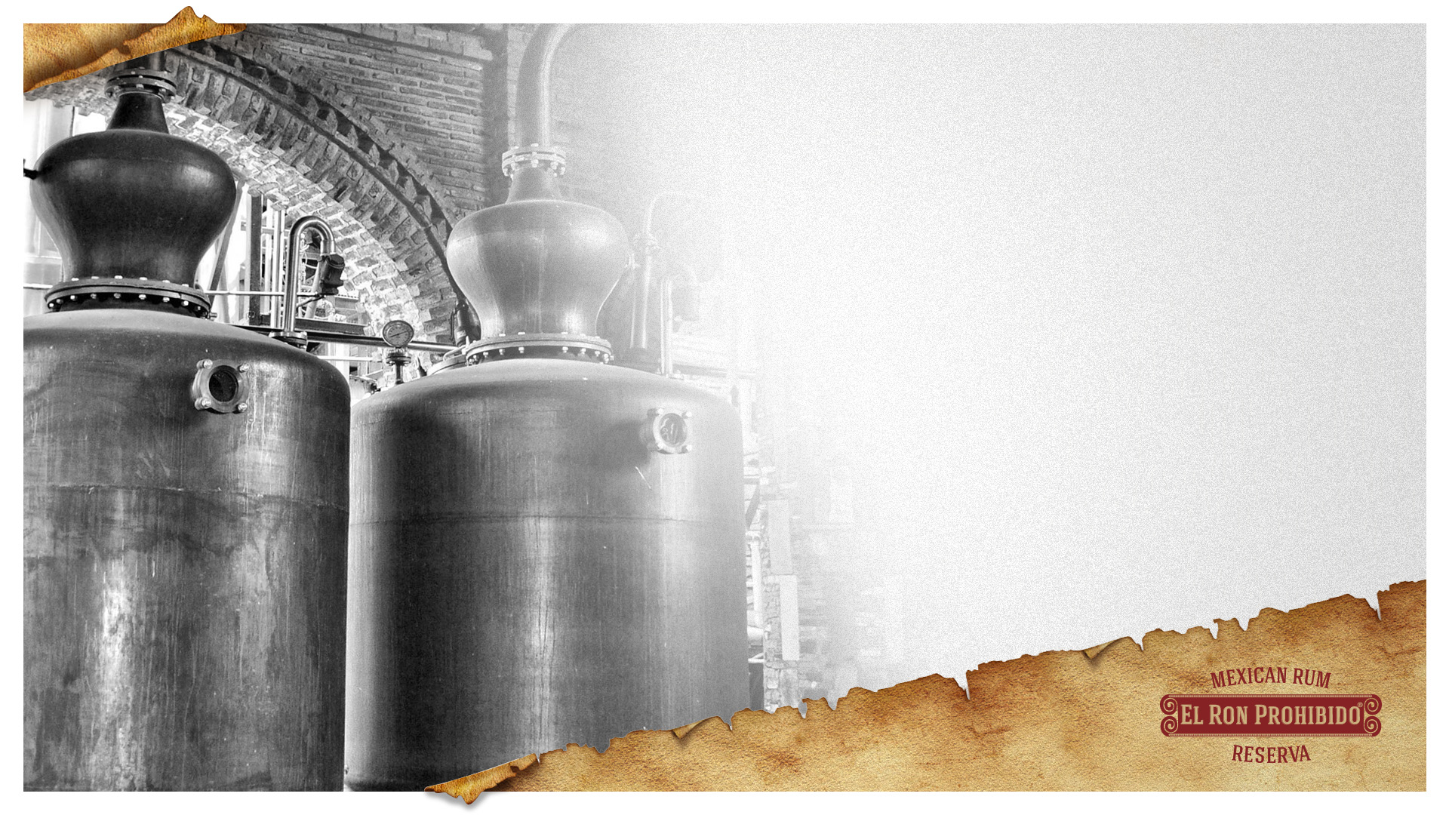

The mosto, or cane wine, is then distilled in copper post stills and distillation columns. Here´s where things get really interesting. After the rum exits the still, it is placed in the distilerry´s Solera, a system for maturing spirits and fortified wines perfected.

Slide 6
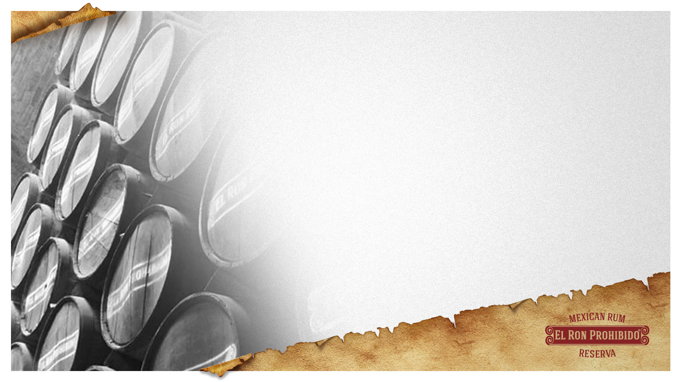

Aged in American oak barrels that were used to rest raisin wine and from which, their characteristic aromas and flavors are obtained.

Slide 7
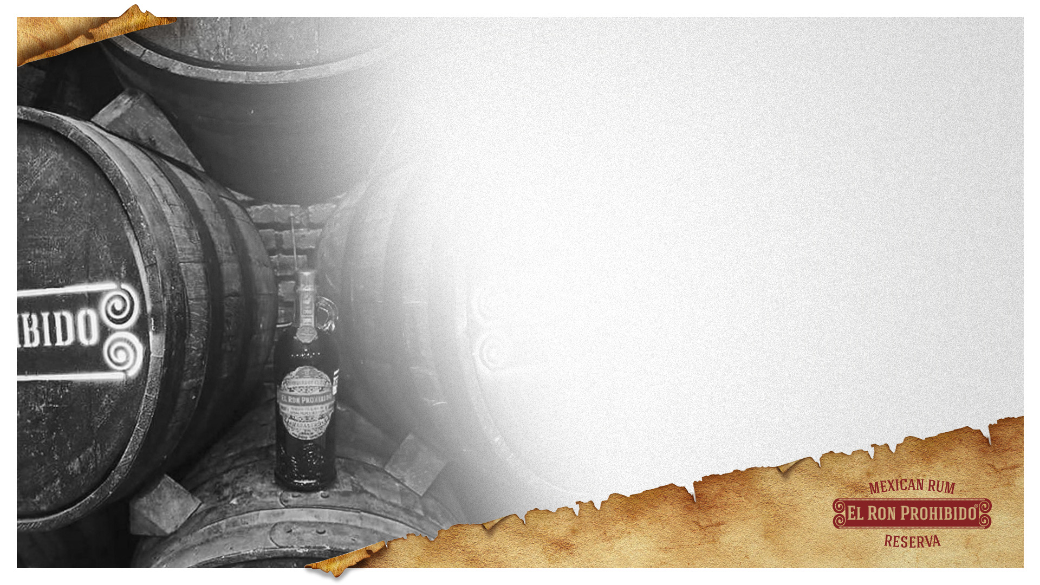

Under the solera system, new rum batches are mixed with older batches. The older rums educate the younger ones, enhnasing their taste and character. The system utilizes a series of oak casks arranged in 3 tiers. The barrels on the top contain the youngest rums, those on the middle tier contain older rums and the barrels on the bottom are filled with the oldest.
The rum combination from different ages, gives a complete sensory profile.

Slide 8
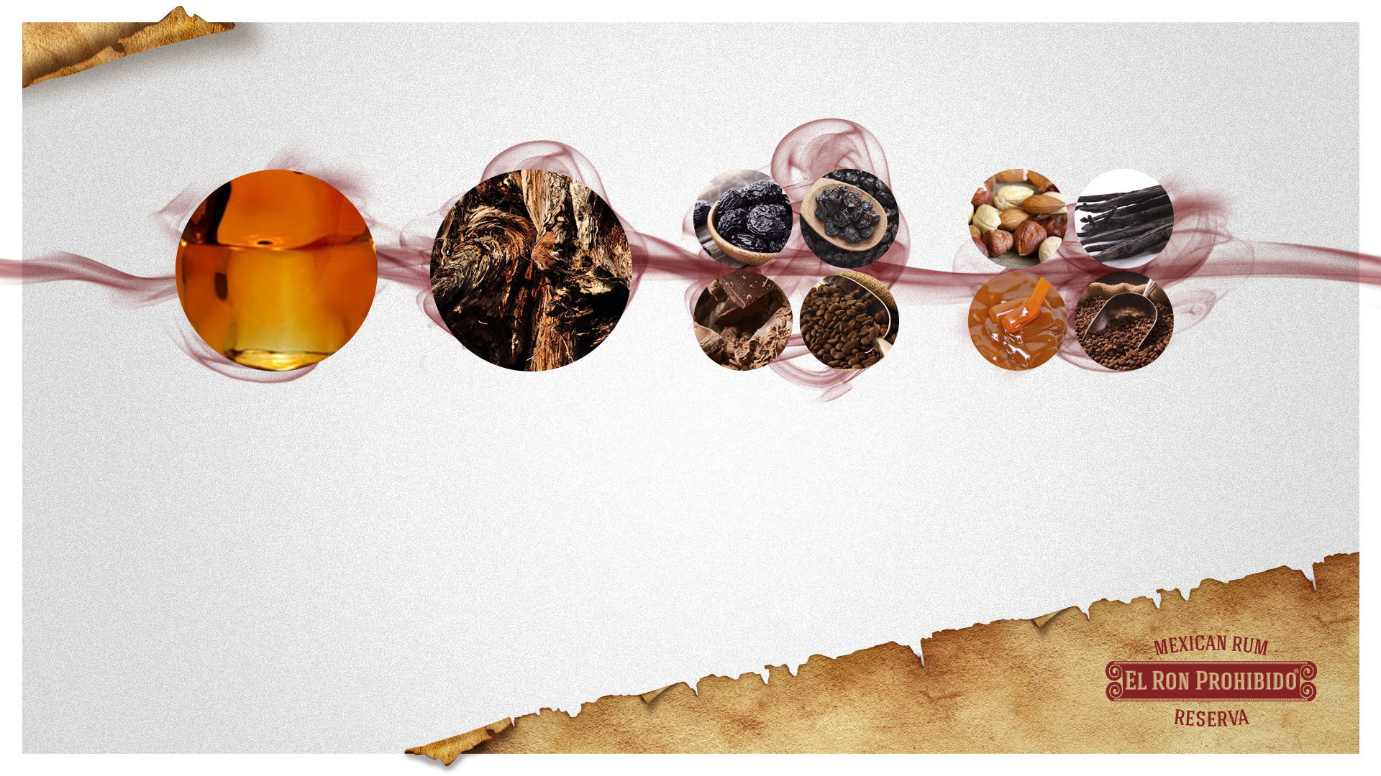

Taste:
Raisin and prunes with hints of chocolate and coffee.
Finish:
Long and silky dry fruit flavors with accents of vanilla chocolate, and coffee with a touch of caramel
Appearance:
Dark brown with flares of red
Aroma:
Sweet notes of timber and raisin

Slide 9
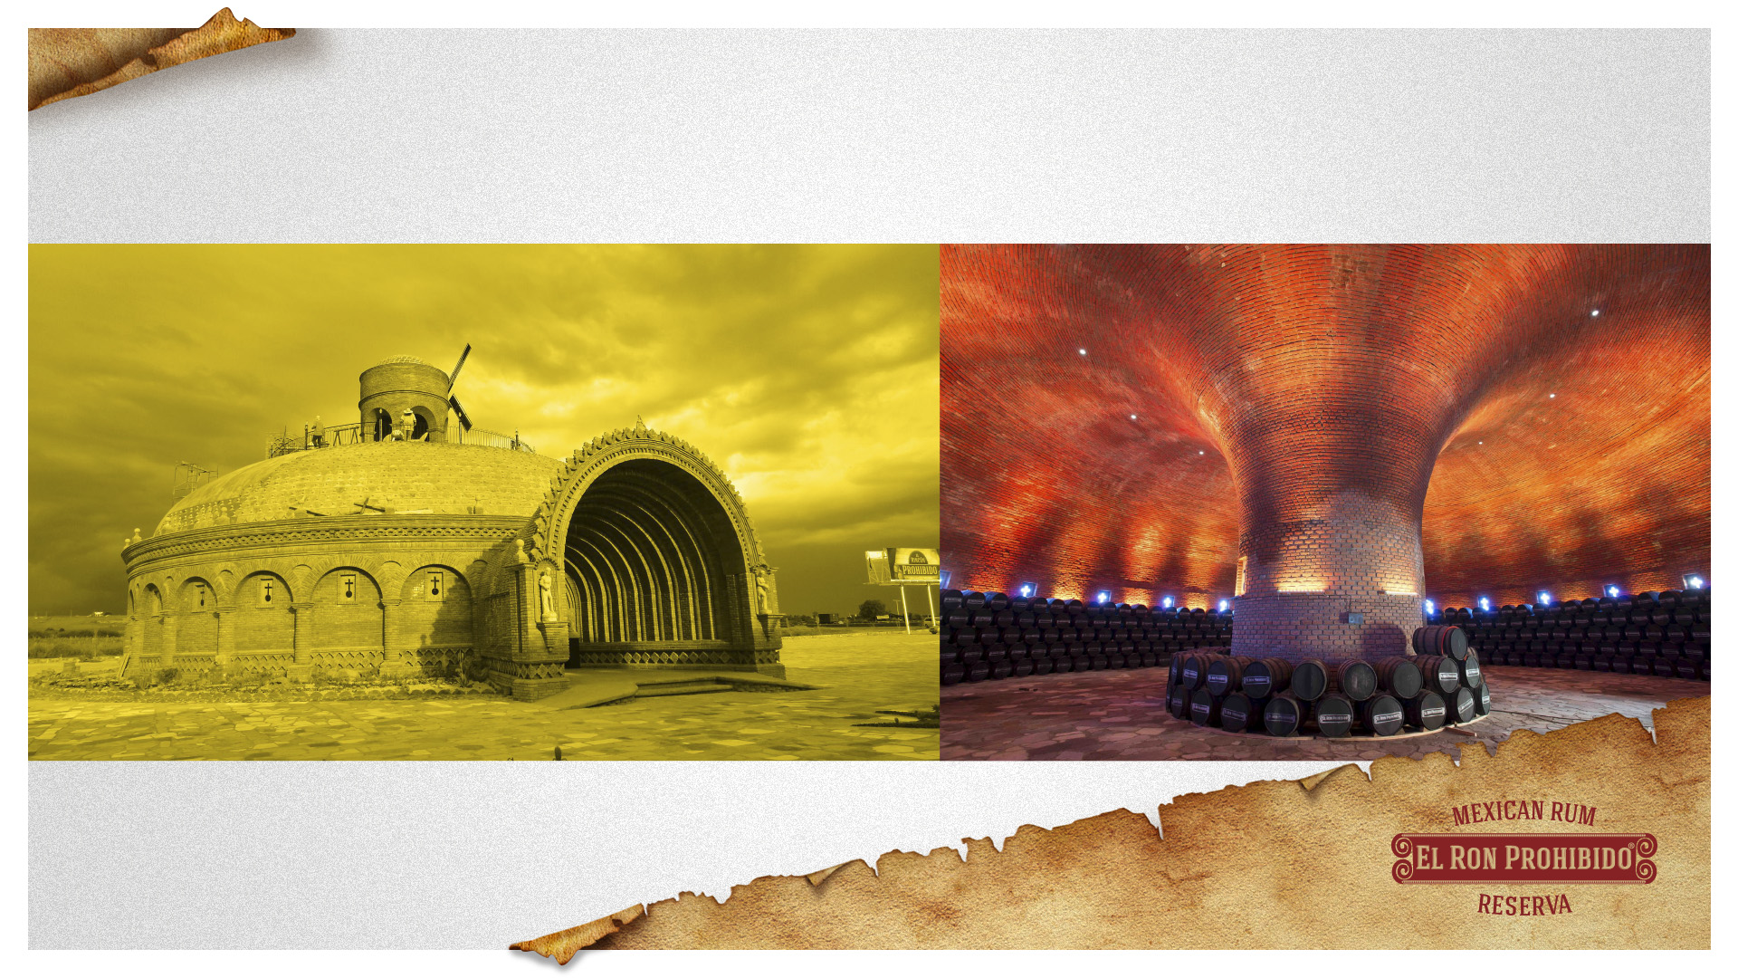
El Rincón Prohibido
At this far, this is one of the 5 architectonic icons from Hacienda Corralejo, sitting in Silao, Gto, This beauty complex was built and dedicatted to RON PROHIBIDO, here is where we storage all the barrels in the aging process, also this is a free touristic destiny.

